Slide 1
ARGIS, June 4, 2014
ArcGIS online, Open Data and ARC
Ryan Barrett and Landon Reed

Slide 2
Outline
What is open data?
ARC’s data provision goals
Demo of ARC’s open data site
Applications

Slide 3
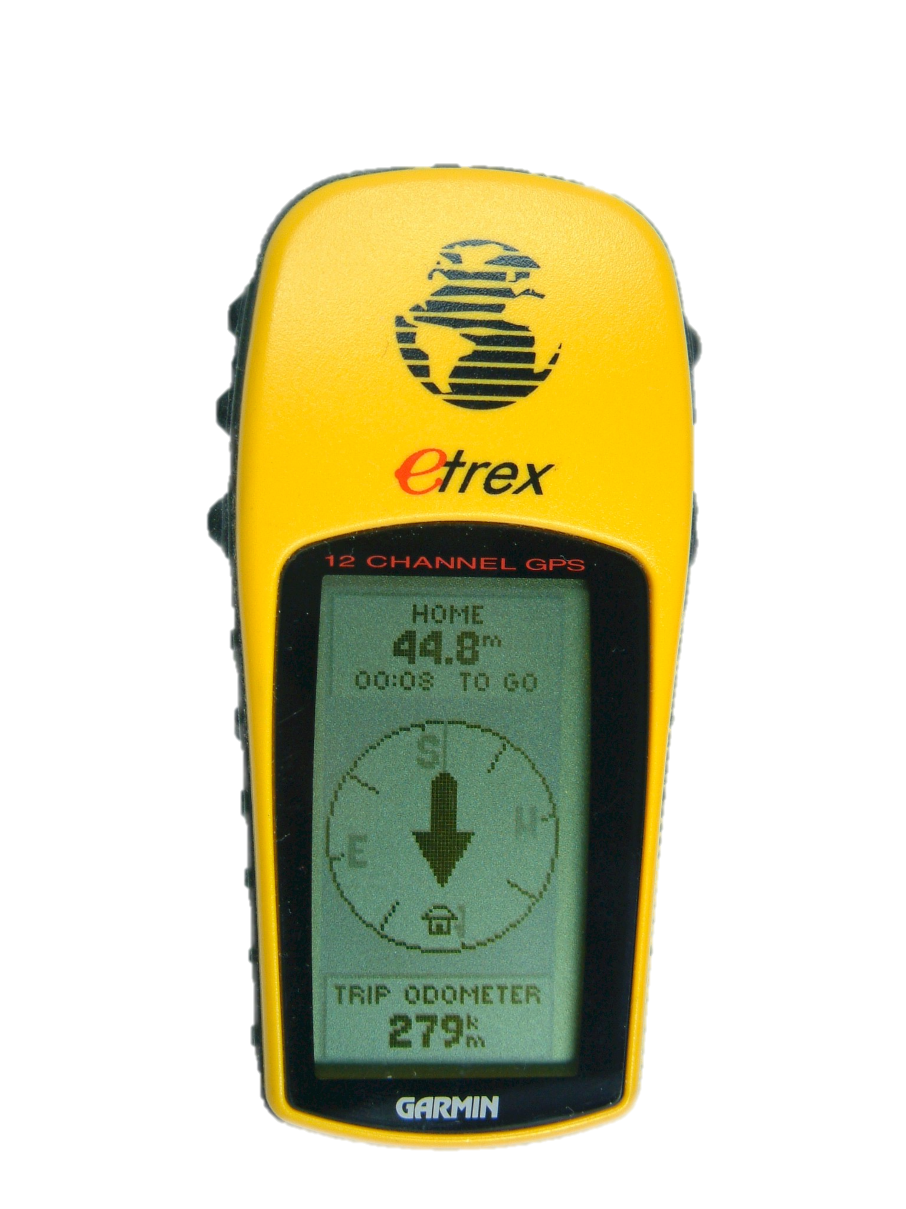
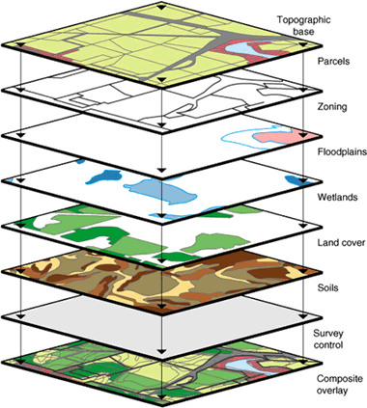
What is open data?
Open data?
Data provision
Demo
Applications
Providing government data in a machine-readable, often standardized, format
GPS
Weather
GIS?

Slide 4
Presidential Executive Order
Open data?
Data provision
Demo
Applications
May 9, 2013 mandate that all federal government data should be made open and available by default.
Why?
Economic
Competitiveness
Operational Efficiency
Interoperability
Transparency
Community

Slide 5
ARC’s data provision goals
Open data?
Data provision
Demo
Applications
Good discovery (e.g., explore data on a map)
Up-to-date
Easy to use
Easy to maintain

Slide 6
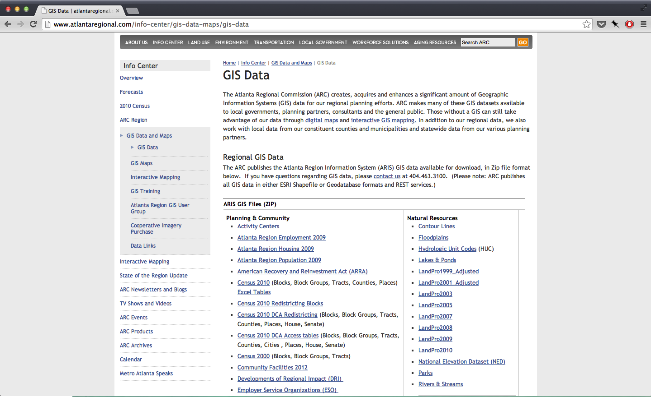
Current data provision model
Open data?
Data provision
Demo
Applications
Lots of fetching…

Slide 7
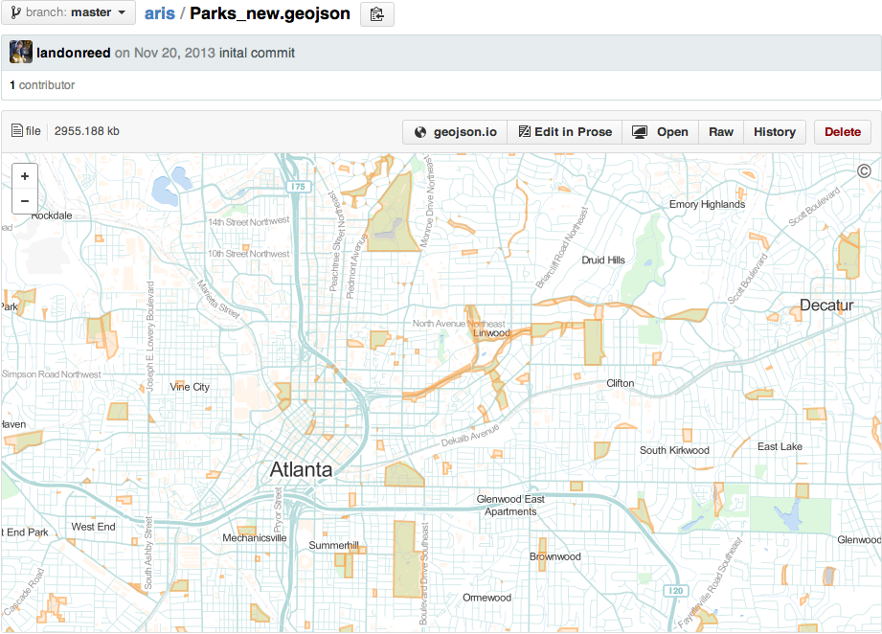
Open data?
Data provision
Demo
Applications
Other data models
?
GitHub repo
Esri open data site

Slide 8
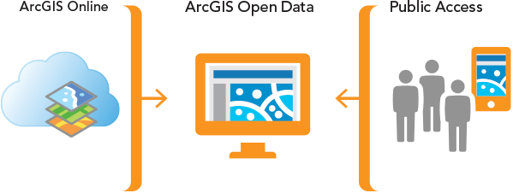
Esri open data model
Open data?
Data provision
Demo
Applications

Slide 9
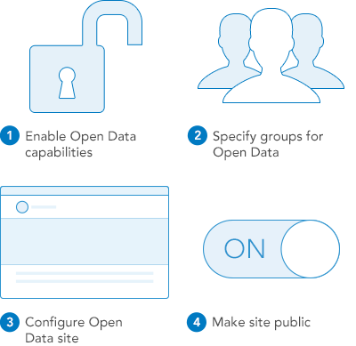
4-step deployment
Open data?
Data provision
Demo
Applications

Slide 10
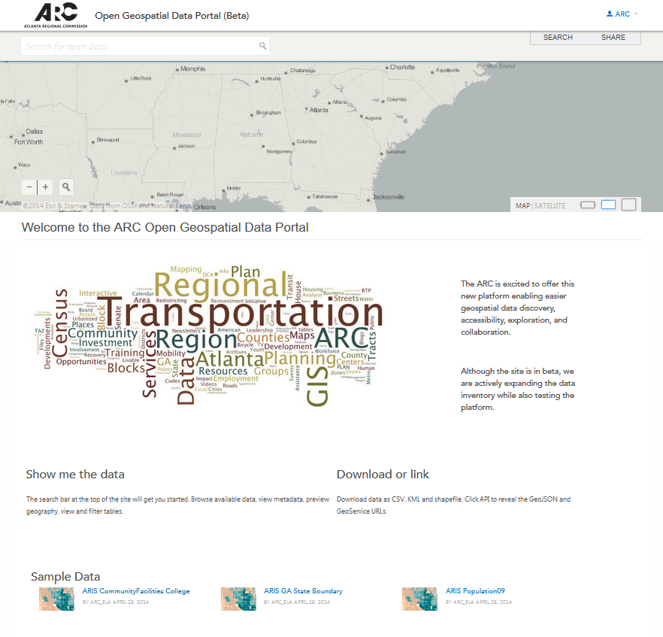
Demo (rest of Ryan’s slides)
Open data?
Data provision
Demo
Applications

Slide 11
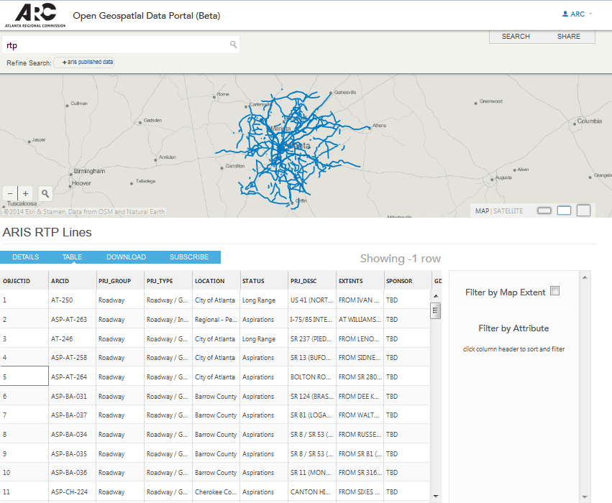
Open data?
Data provision
Demo
Applications

Slide 12
Lessons Learned
Open data?
Data provision
Demo
Applications
Sharing (public group + everyone) CSV/Shp downloads require .csv/.zip Thumbnails List Other comments?

Slide 13
Next Steps
Open data?
Data provision
Demo
Applications
Migration metadata/tags Replace GIS data page Promote collaboration

Slide 14
Applications: GeoJSON web service
Open data?
Data provision
Demo
Applications
GeoJSON is a geospatial format optimized for use in web applications
Open data site allows developers to easily include web service (that stays up-to-date!) in web map
http://atlregional.github.io/geojson-test/esri.html

Slide 15
Applications: Combining datasets
Open data?
Data provision
Demo
Applications
As other jurisdictions upload their data to such sites, similar datasets can be viewed in conjunction
Agencies can still maintain own data
Opportunities for standardizing how data is created and maintained

Slide 16
Online Resources
Open data?
Data provision
Demo
Applications
Esri Open Data
ESRI getting started ESRI sample site Data Driven Detroit Site ARC Open Data Site Open Data
Open Data Institute Blog
Using GeoJSON with Leaflet

Slide 17
Open data?
Data provision
Demo
Applications
Questions Comments?

