Slide 1

Douglas County’s GIS
&
Web Analytics for Public Mapping Applications
ARC October 1 2014
Andy Summers, GIS Manager

Slide 2
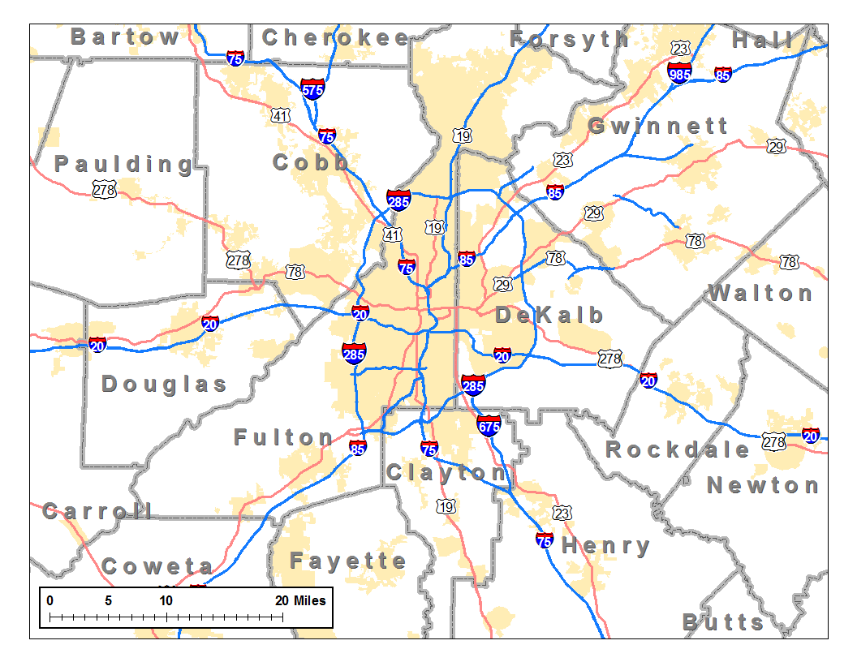
Who what when where
Douglass County established 1870
Population: 132,400
Total Parcels: 53,950
1,025 Road Miles
County Boundary: 200 Square Miles
Commissioners Rule
You are here
We are here
ATL

Slide 3


…in the year 2006
Coverage
SHP
CAD
MXD
APR
Shared
File
Server
GIS Department
}
PC
Coverage
SHP
MXD
Shared DB Server
CAD
SID
APR
5
PC
Maps
R US
SDE
GIS
Tax
Appraisal
Coverage
TIFF
MXD
PC

Slide 4





Set the table for advancement…
Checklist
Understand the mission
Gather and organize
Prioritize
Consolidate/Cleanse
Process Improvement
Integration
Work on filling gaps
Pretty Maps
but…

Slide 5
Reaching Users
Engineering
Environmental Health
DA & Solicitor
Fire
DOT
ArcReader
P & Z
Commissioners
Public Defender
Code Enforcement
Risk Management
Building Inspections
Sheriff
Appraisal
Tax Commissioner
911
Team
GIS
Voter/Elections

Slide 6

Develop a web presence
County does not have web hosting capabilities
Tax Commissioner and GIS share hosted service…
Tax Bill and Limited Mapping
Appraiser uses hosted service…
Q
Property Appraisal and Limited Mapping

Slide 7
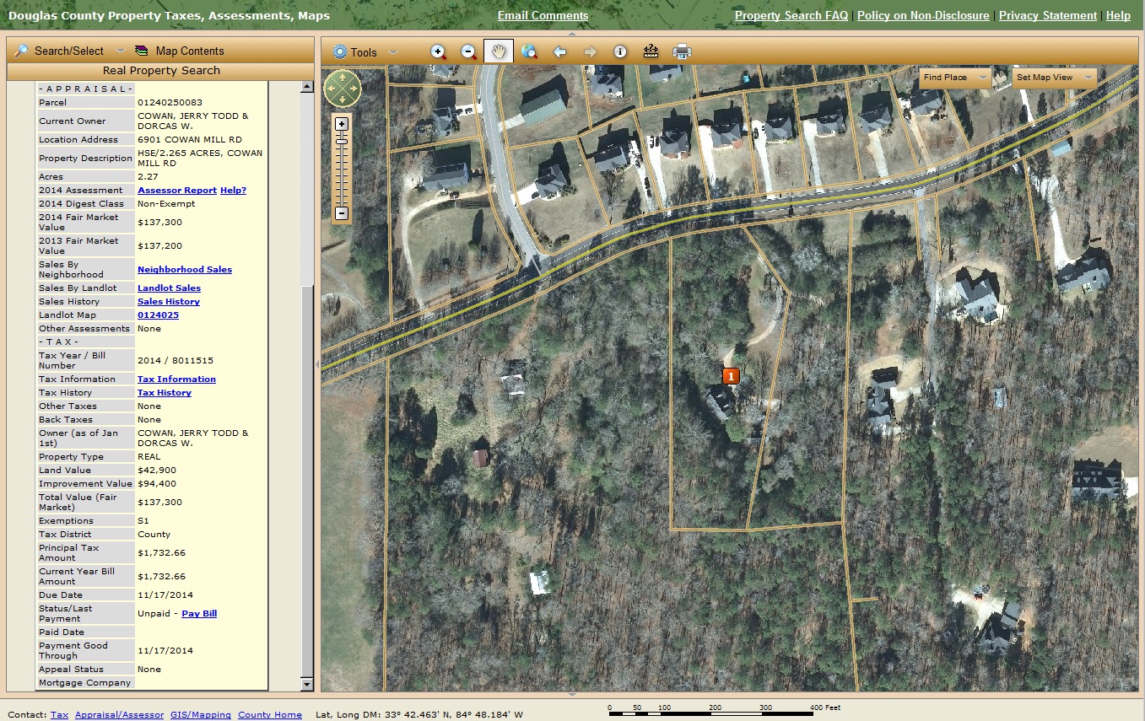
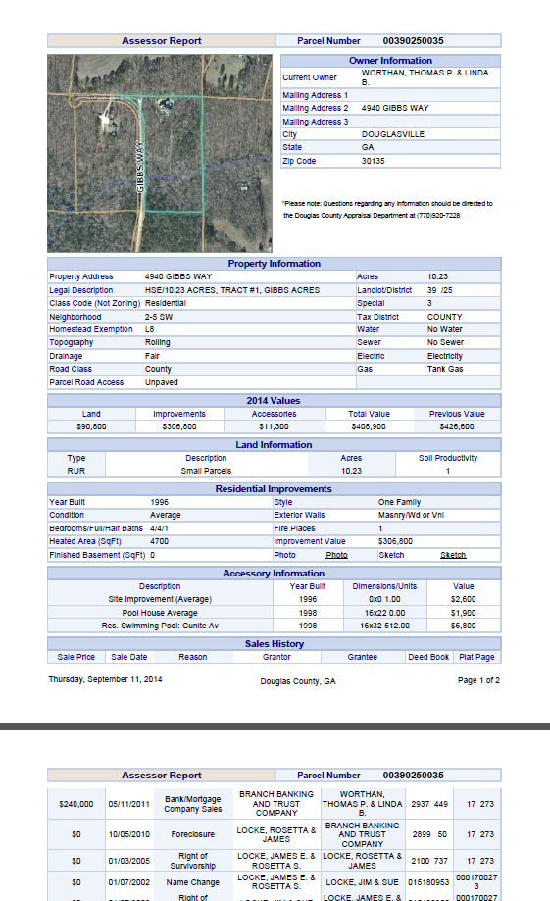
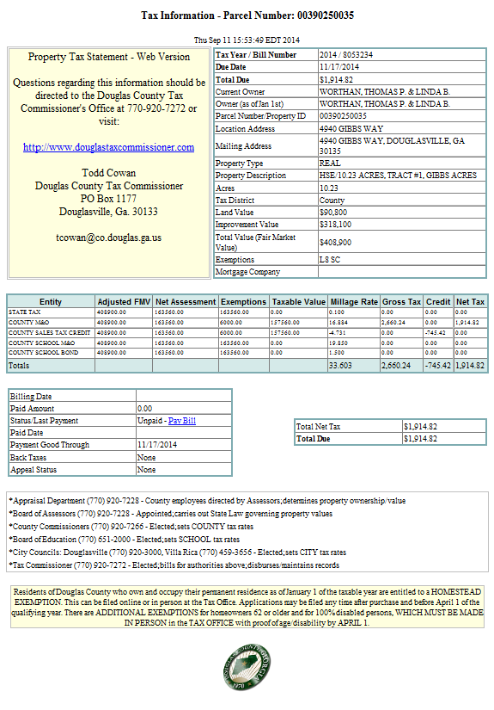
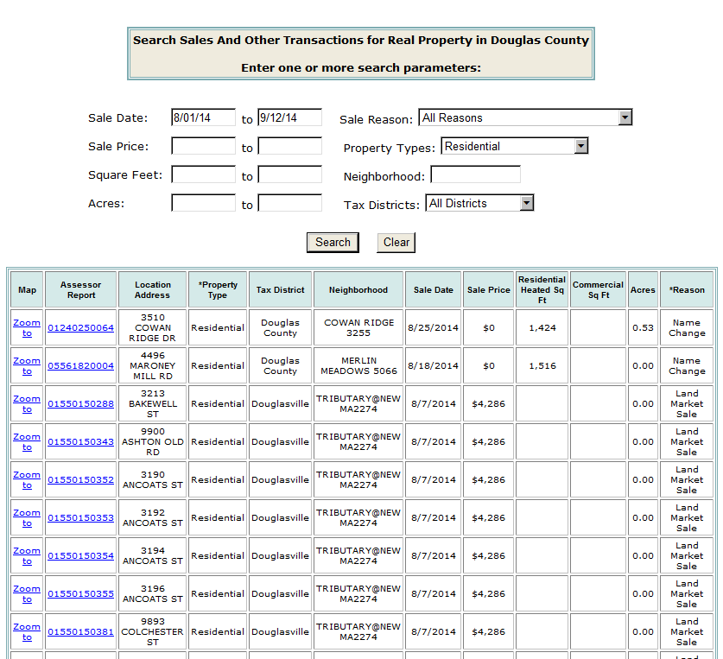
Property Information Website

Slide 8
Ownership has its privileges?
Performance and usability are controlled and improved
Hands on experience managing all components of the site
Solid base to add more applications (mobile)
Public not shy about offering feedback
99% of feedback is positive and constructive
Leaders are happy
“GIS provides an integrated Tax Commissioner Information System, Tax Assessors Information System, and GIS System. This system has significant utilization/exposure throughout Douglas County. My office and I rely heavily on this integrated system….especially during Tax Season. I believe we have one of the best systems in the state.”
“I’m a professional tax consultant with 35 years’ experience in local government and business. Your web site is awful. Can’t find the data needed. I doubt the Assessor Office find it very easy to work either. As a property owner rep, I’m the customer. If your website was a store, I’d shop elsewhere. But we can’t because the County has the monopoly on tax data. You’re the expert. Do some tests, invite the public to try it and see what they say.”
Bearing responsibility for uptime
Nearly impossible to please all users all of the time
Bad feedback

Slide 9
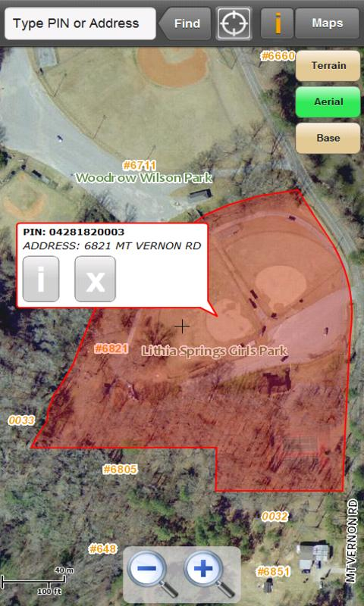
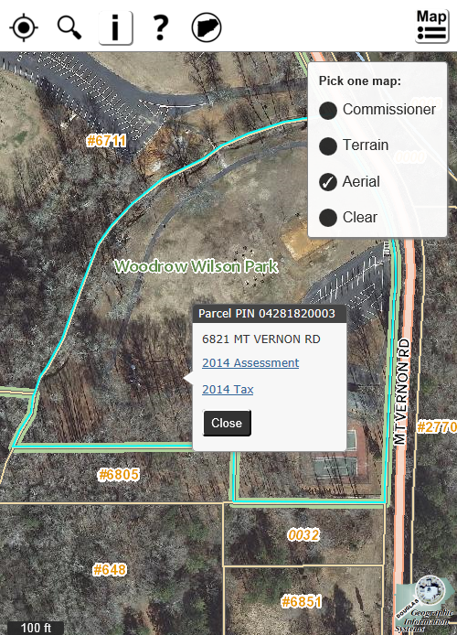
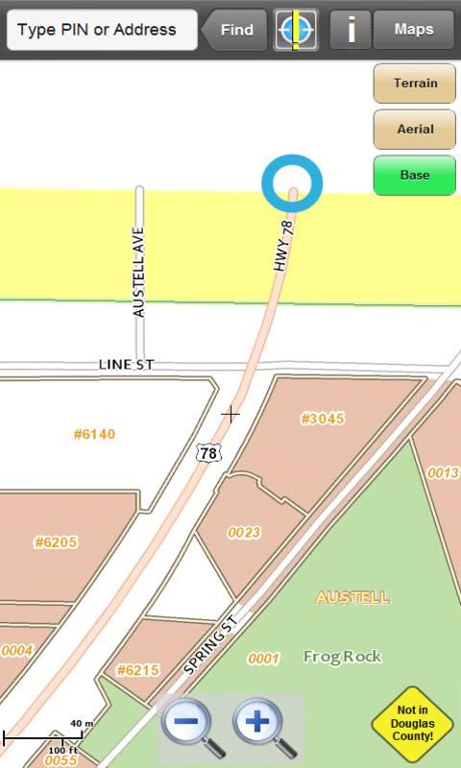
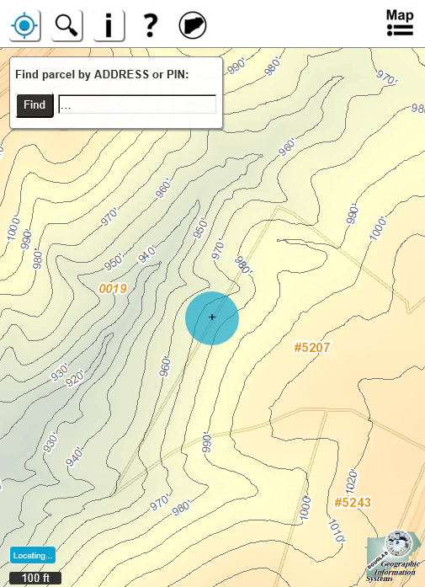
Mobile
Jan 2012 – Android only (Flex API)
Jul 2014 – All devices (JavaScript API)

Slide 10
Recent developments and future goals
Migrated production environment off of shared physical server and onto virtual server (including upgrade of SQL Server from ancient release)
Android mobile app off of the market (all-in on JavaScript)
Upgrade web server
Rewrite Property Info Website (bye-bye ADF)
Use ‘thinner’ solution for internal client access

Slide 11
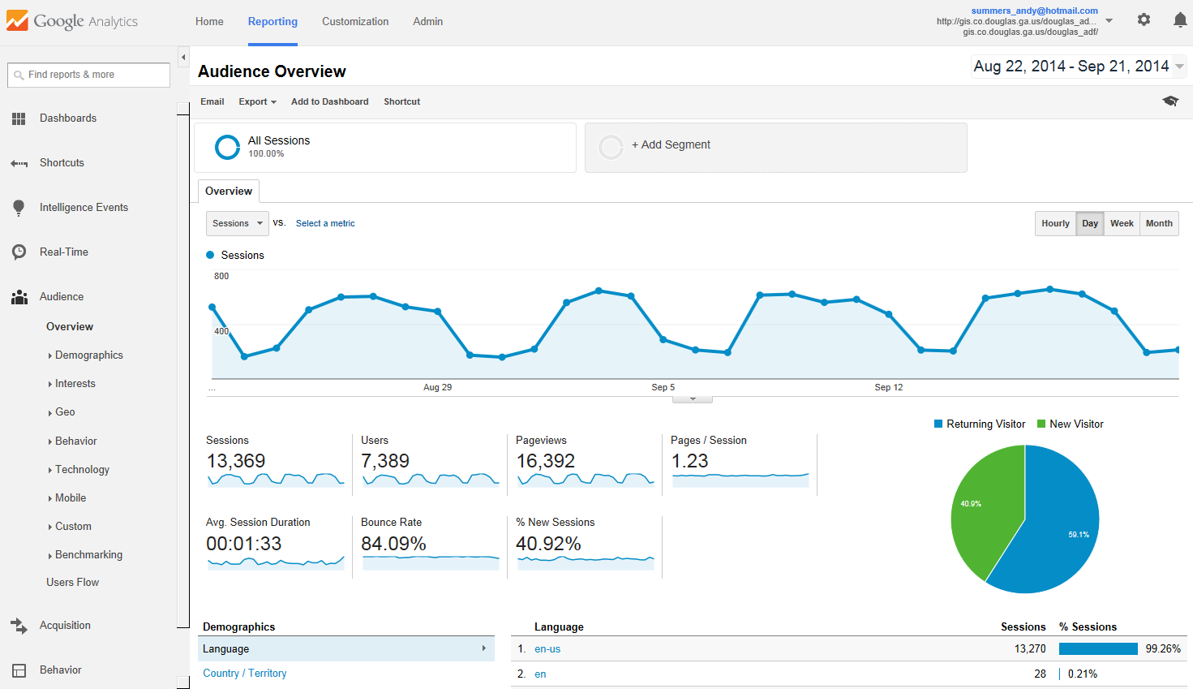
Web Analytics
Collected using Google Analytics
User Count / Geography / Browser - OS - Device / Network / Traffic-Referral

Slide 12
Web Analytics
Property Information Website
* Current count is 115,204 – on pace for 165,000

Slide 13
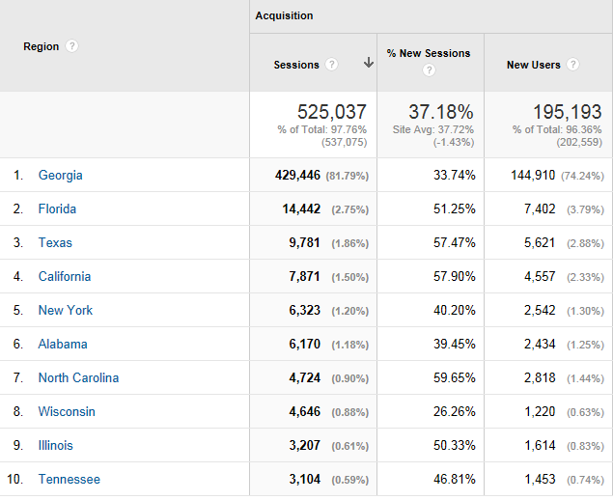
Web Analytics
Property Information Website
Geography by state for all years

Slide 14
Web Analytics
Property Information Website
Browser usage by year

Slide 15
Web Analytics
Property Information Website
Operating System usage by year
Note: 59% of all mobile users are using iPad and iPhone

Slide 16
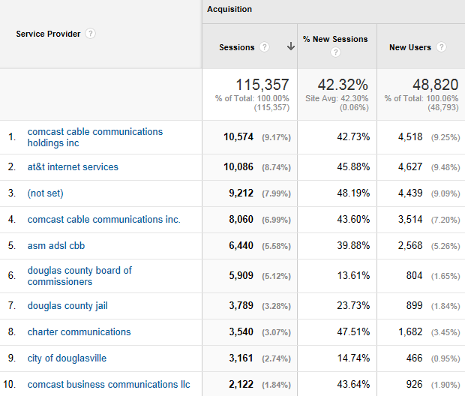
Web Analytics
Property Information Website
Network - 2014

Slide 17
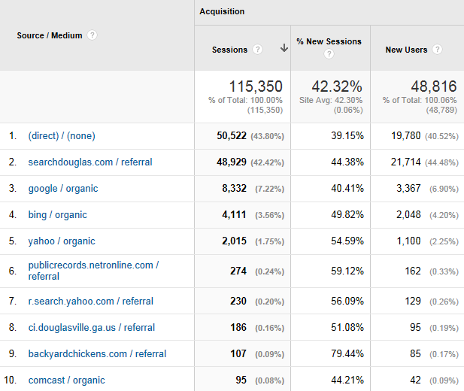
Web Analytics
Property Information Website
Traffic-Referral - 2014

Slide 18
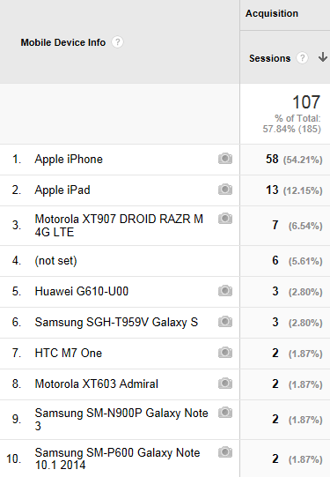
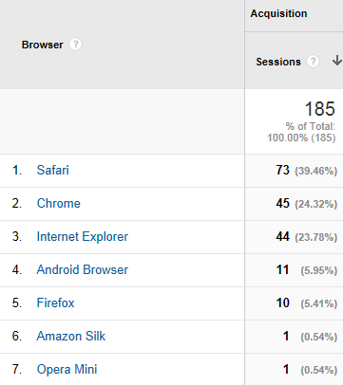
Web Analytics
Douglas County GIS Mobile (JavaScript API)
Device
Browser

Slide 19
Douglas County’s GIS
The End
&
Web Analytics for Public Mapping Applications
ARC October 1 2014

