Slide 1
Address/Parcel/Owner Business Process Assessment Findings & Recommendations
Presented to
Atlanta Regional Commission
Atlanta Region GIS User Group
By APO Project Team
Date: June 4th, 2014

Slide 2
Agenda
APO Project Objectives
Business Process background
Agencies Involved:
City of Atlanta – Department of Planning
DeKalb County GIS
Fulton County Tax Assessor GIS
Fulton County Clerk of Superior Court
Findings / Recommendations
Next Steps
Q & A

Slide 3
Work in a collaborative fashion with City of Atlanta, DeKalb County and Fulton County (Multi-Agencies) to:
APO Project Objectives
Identify APO Business Process Hand-Off /
Receipt Challenges
Identify / Implement Win-Win Business Process
Improvement opportunities
Create greater Efficiency in Hand-Off’s between
Multi-Agencies

Slide 4
Business Process Improvement
Business Process Improvement

Slide 5
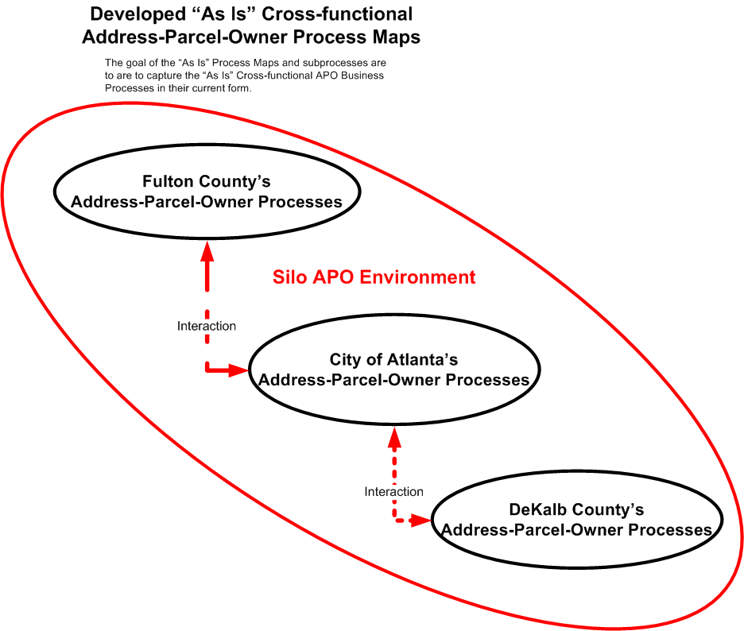

Slide 6
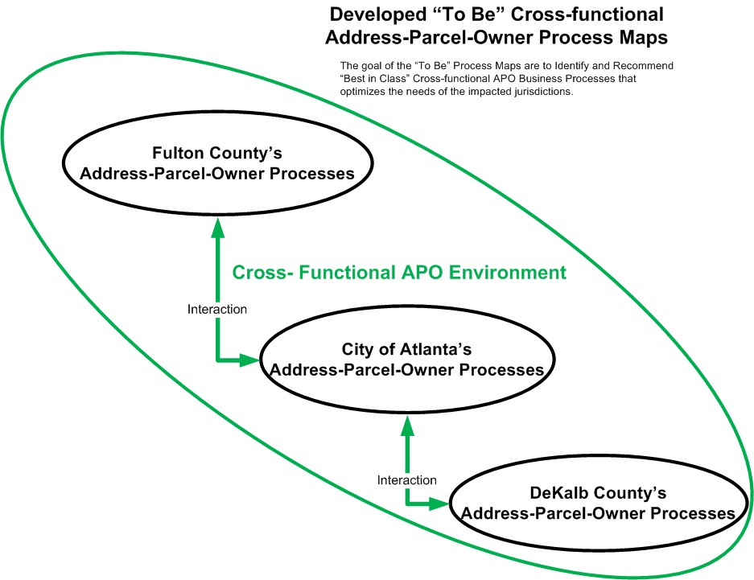

Slide 7
Multi-Agency APO Accomplishments
Mapped, identified and validated the City of Atlanta, DeKalb County and Fulton County “As-Is” and “To Be” processes and identified challenges and recommendations:
Citizens unaware of the process for altering Lot Boundaries
County Parcel modifications can create non-conforming lots
Zero addresses are created when the County subdivides a parcel
No formal process for generating permanent parcel ids from temporary ids in Accela
We identified process improvements and the opportunities to improve hand-offs (City & County) developed Best in Class recommendations. **
Present Findings and Best in Class recommendations to COA Management

Slide 8
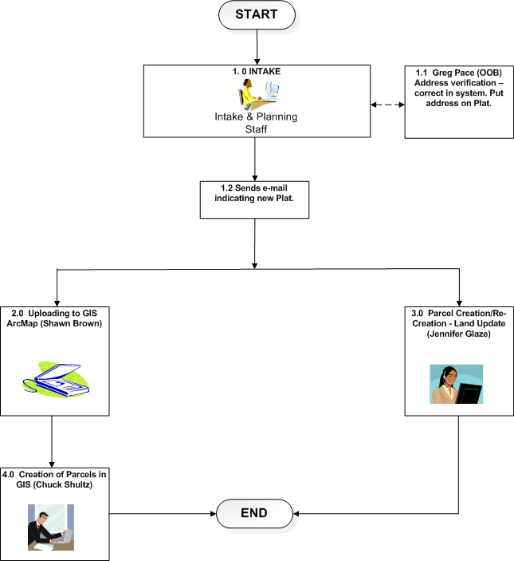
City of Atlanta High Level Process
Maps

Slide 9
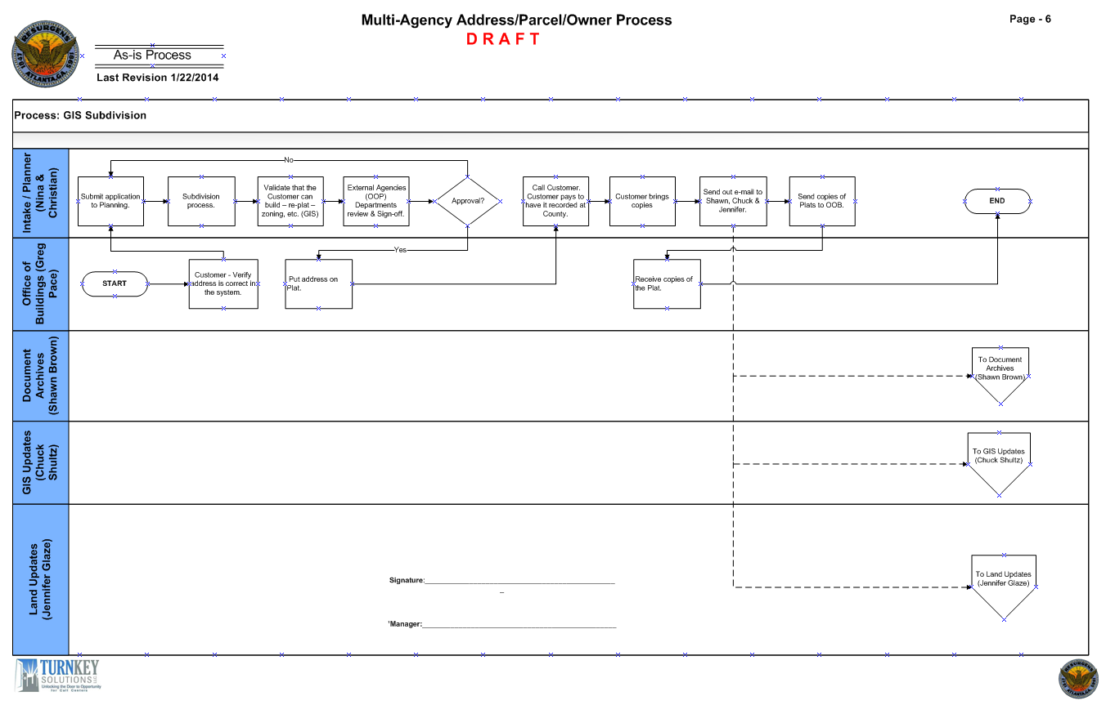
City of Atlanta GIS Subdivision
Notes:
Quickly explain this map.

Slide 10
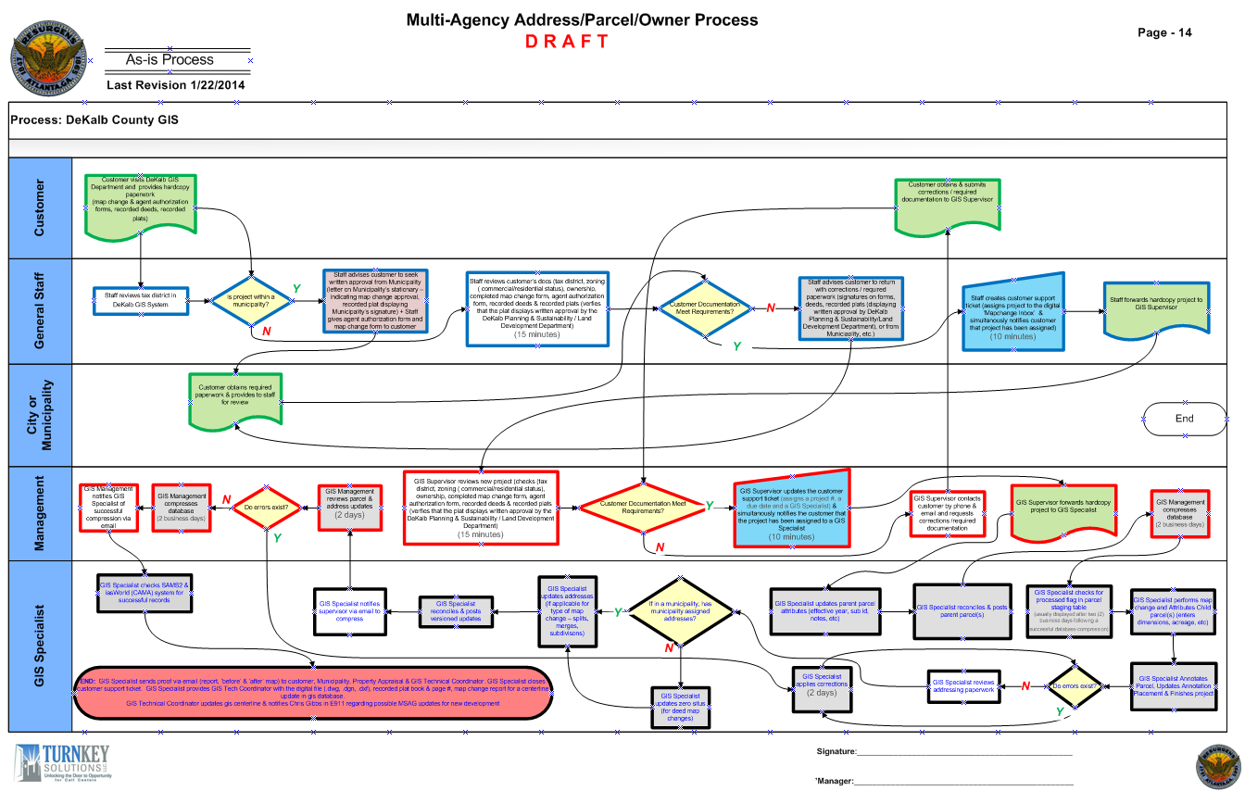
DeKalb County GIS
Notes:
Quickly explain this map.

Slide 11
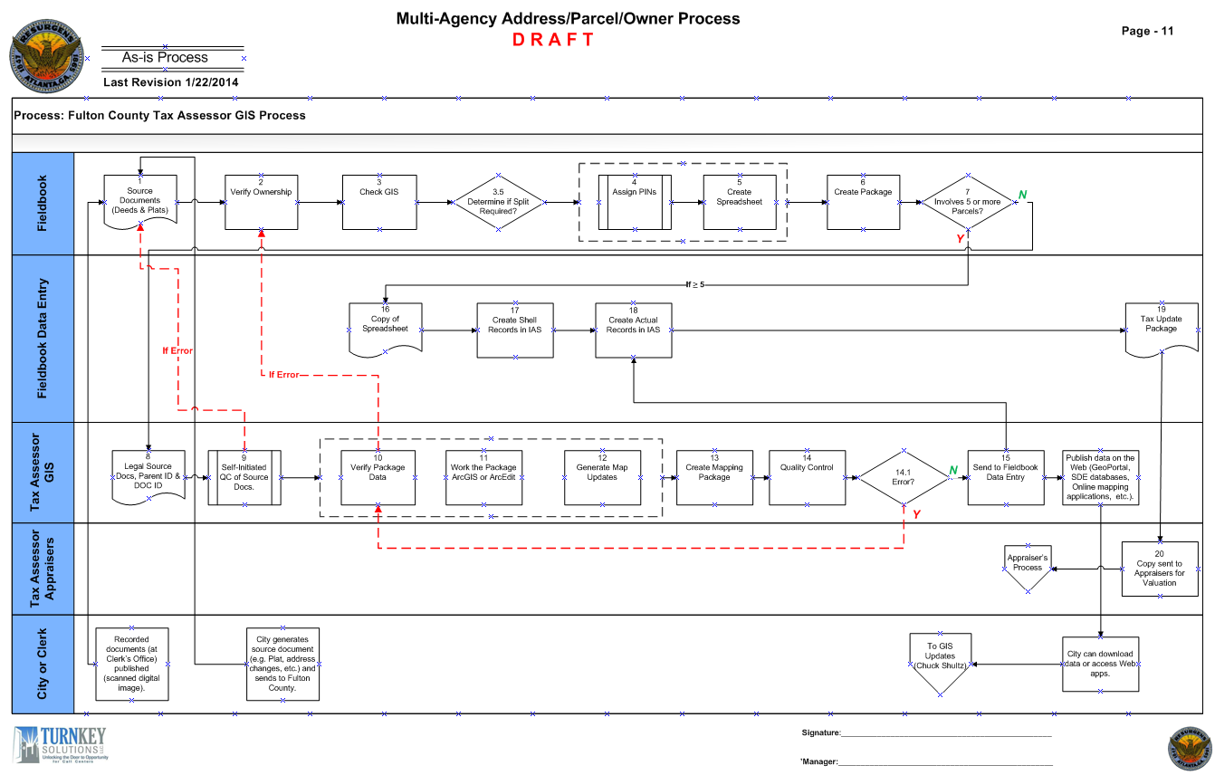
Fulton County Tax Assessor GIS
Notes:
Quickly explain this map.

Slide 12
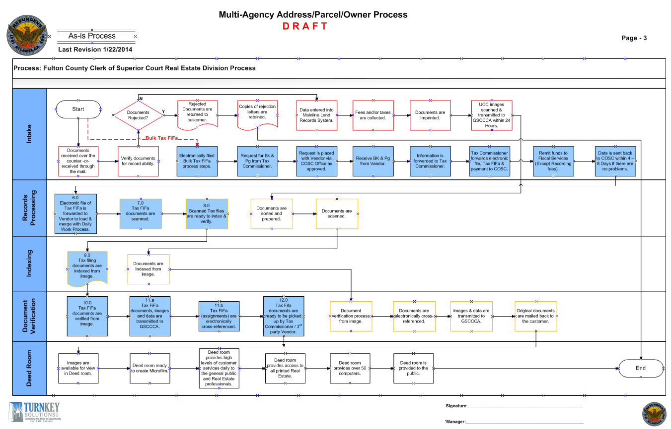
Fulton County Clerk of Superior Court
Notes:
Quickly explain this map.

Slide 13
Findings and Recommendations
Multi-Agency Address / Parcel / Owner
Findings
Recommendations
Priority I
Ability to educate customers on the process for updating property boundaries (e.g. splits, combinations, parcels and re-parcels).
Priority I
Short Range – Counties research & develop a Web Site and conducts a Marketing Campaign to educate customers on how to easily submit their property boundary update requests.
Medium Range – Citizens should record plats at the County only after final address is approved by the City of Atlanta if the property is in the City of Atlanta
Long Range – Join the effort with the Municipalities to change State Law.

Slide 14
Findings and Recommendations
Multi-Agency Address / Parcel / Owner
Findings
Recommendations
Priority II
Counties do not require an approval COA Stamp for approved lots.
Customers can alter and record Plats through Counties and create unapproved lot configurations without the City (COA GIS) being aware.
Priority II
Collaborate with Counties on a method for eliminating unapproved lots. Agree on resolution for recording and altering Plats.
Notes:
Quickly explain the priority (already mentioned) and the recommendation

Slide 15
Findings and Recommendations
Multi-Agency Address / Parcel / Owner
Findings
Recommendations
Priority III
Zero Addresses – When the Counties split a property by a recorded deed, they assign a Zero Address to the Parcel until the City provides a permanent address.
By Law Dept. advised the Counties are required to convey properties per the legal description.
Although the legal description may result in a parcel being a non-conforming lot, the Counties still have to create an address for the parcel.
Priority III
When this happens, an address should be requested from the city immediately. Set a Microsoft Outlook reminder for 1 week from the request date. If no response is received from the City within a week, follow-up with a phone call to (Office of Buildings) the City.
This process is obviously iterative until resolved.
Notes:
Quickly explain the priority (already mentioned) and the recommendation

Slide 16
Findings and Recommendations
Multi-Agency Address / Parcel / Owner
Findings
Recommendations
Priority IV
Temporary Parcel IDs to Permanent Parcel IDs in Accela – No process for this right now.
Priority IV
** Map out a Business Process for converting Temporary IDs to Permanent IDs in Accela. Preferably receive the Fulton County Plat Report on a daily, weekly or monthly basis versus annually.
Also, Share Physical Data (Line Work, Parcel Layer changes) with Counties.
Create a unique identifier (e.g. Serial Number) for each parcel to be used by County Assessors and by the City to provide a solid way to pull in County information. Has to be done by the County Courts.
**
This recommendation has
been implemented.

Slide 17
Recommendations & Next Steps
COA Action Items
Develop a vehicle for educating customers on APO processes
COA to establish Multi-Agency APO policies, procedures and Business Processes that will facilitate the elimination of the Temporary Parcel IDs and Zero Addresses that we’ve identified in our findings & recommendations
Players:
COA Office of Buildings / COA Office of Planning
Appropriate DeKalb (GIS Group) & Fulton (Tax Assessor GIS & Clerk of Superior Court) County Resources
Develop a formal and electronic delivery mechanism to get Fulton County information updated (versus the manual process that we’ve put into place)
Ownership & Management of Recommendations

Slide 18
Questions
?

Slide 19
Thank You!
CONTACTS:
Greg Kiah
Paul Thomas
Ron Booth
Gary Cage

