Slide 1
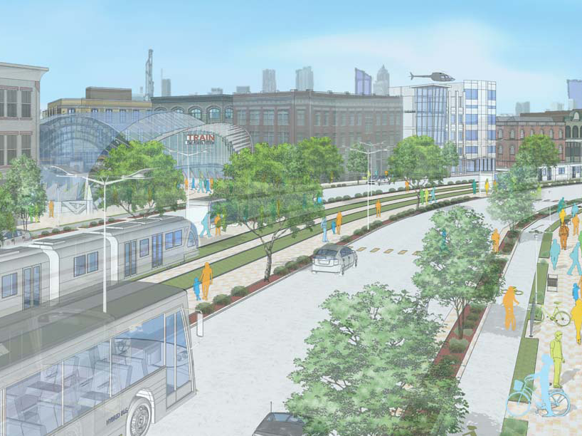
REGIONAL TRANSPORTATION REFERENDUM
March 22, 2012
Notes:
Good Afternoon. My name is ( ). ARC is the regional planning agency for the metro region and we are committed to informing every citizen regarding an important vote on July 31.
I am here today to give you some important facts about the Regional Transportation Referendum and the choice you have to generate new funding for transportation improvements throughout our 10-county region.

Slide 2
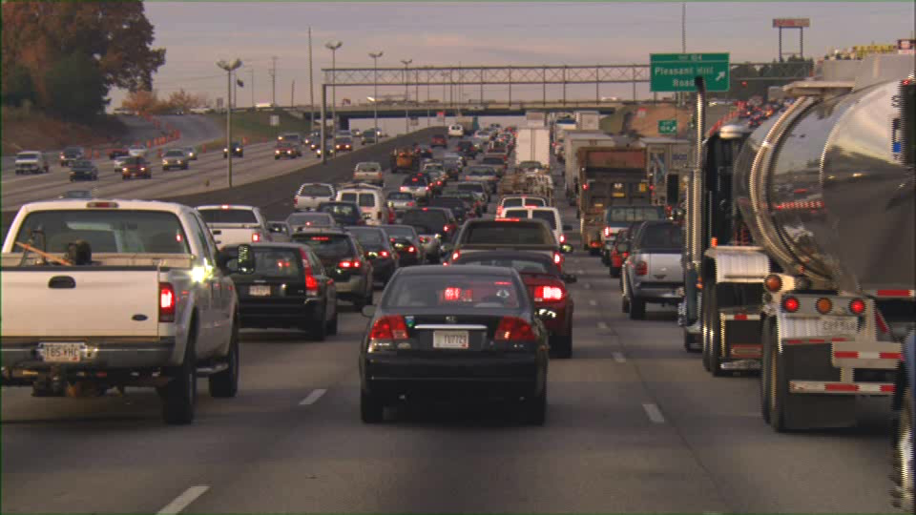
Transportation is the lifeblood of the region
Notes:
How many of you drove during rush hour today?
If you did, your commute probably looked something like this.
If you did not, count yourself Lucky because this is a typical day on any of our key roadways
Every day, you and hundreds of thousands of metro Atlanta residents leave home headed to work, school or other destinations throughout our region.
But sometimes we need to get out of our own car and think about traffic congestion on a regional level.
After all, travel is regional in nature. Roads, rail lines and trails don’t stop at county lines.
In fact, 38 percent of all trips taken throughout the metro Atlanta area – for any reason - go across county lines.

Slide 3
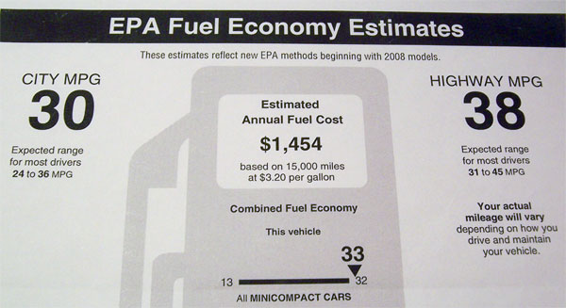
Our vehicles are more efficient, reducing gas tax revenue
Notes:
Why is traffic congestion such a challenge in metro Atlanta? One factor is our region’s success and growth. We’ve gained one million people during the last decade.
And, we have a transportation funding deficit. Almost all of our federal and state transportation money comes from gas taxes we pay at the pump. Gas tax revenue has been declining for years our cars become more and more fuel efficient.
Since 1980, the fuel efficiency of the average passenger car sold in America has increased by 40%, from 24.3 mpg to 33.8.
And… Georgia has not raised the Motor Fuel Excise Tax since 1971. Could you maintain your business or your home on the income you would have received in 1971?

Slide 4

Nearly three million more people will call our region home in 30 years
Notes:
And, our region is not going to stop growing.
Metro Atlanta is now home to more than 5 million residents. ARC forecast that 3 million more people will live in our region by 2040.
Adding 3 million more people and their cars is like adding 3 more Fulton Counties or the entire state of Arkansas to the region.
If we don’t expand our transportation system, where will our new neighbors live? How will they get around?

Slide 5

9th worst congestion
48th in spending
Notes:
According to the most recent Texas Transportation Institute study, reduced funding has led to metro Atlanta having the 9th worst congestion of major metro areas in the country.
Between 2003 and 2009, Georgia averaged 48th in transportation spending per capita.

Slide 6
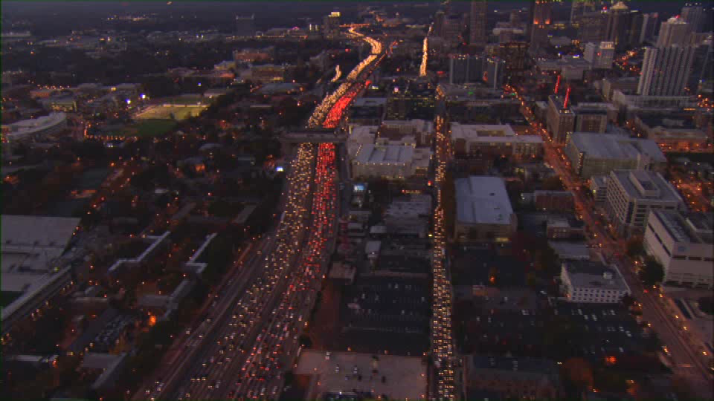
7 of the worst bottlenecks in U.S.
#9 I-285 at I-85 (north)
#20 I-285 at I-75 / Windy Hill Road
#42 I-285 at I-20 (west)
Notes:
Our limited ability to expand the existing system has created bottlenecks.
We are home to seven of the country’s worst freeway bottlenecks, including:
Good ol’ Spaghetti Junction
I-285 at I-75 and Windy Hill Road
And I-285 at I-20 on the west side.
Just in case you were wondering…The intersection of I-285 and Georgia 400 was not ranked because it is not an interstate interchange.

Slide 7

Notes:
Today, we are at a crossroads. With the sales tax resulting from approval of the Regional Transportation Referendum, the citizens of metro Atlanta would have a new method of financing our transportation system to meet our growing needs.
Metro Atlanta has made bold decisions in the past. These bold decisions have made the region what it is today.
We decided to build Hartsfield-Jackson Airport, now the busiest in the world and a major driver of our economy.
We decided to build MARTA, the nation’s 9th-largest public transit system.
We decided to build one of the nation’s largest interstate networks.
The decision made on this referendum may rank as the same type of bold decision needed to keep us competitive in the future.

Slide 8
A Georgia Overview
Transportation Sales and Use Tax
  Creates 12 Special tax districts based on Regional Commission boundaries
  Each district can levy 1% sales tax for up to 10 years
  Money raised in district stays in district
  Roundtables ultimately select projects
  Vote in July 2012 (primary election)
  Funds start flowing in 1st quarter of 2013

Slide 9
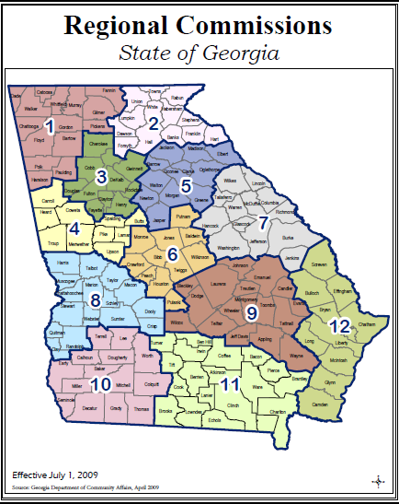

Slide 10
Base Case Forecast Total Collections (2013-2022)
June 14, 2011 Estimate
Regional Commission Amount ($Millions)
1. Northwest Georgia 1,487
2. Georgia Mountains 1,260
3. Atlanta 8,468
4. Three Rivers 947
5. Northeast Georgia 987
6. Middle Georgia 876
7. Central Savannah River Area 841
8. River Valley 594
9. Heart of Georgia 398
10. Southwest Georgia 530
11. Southern Georgia 670
12. Coastal 1,608

Slide 11
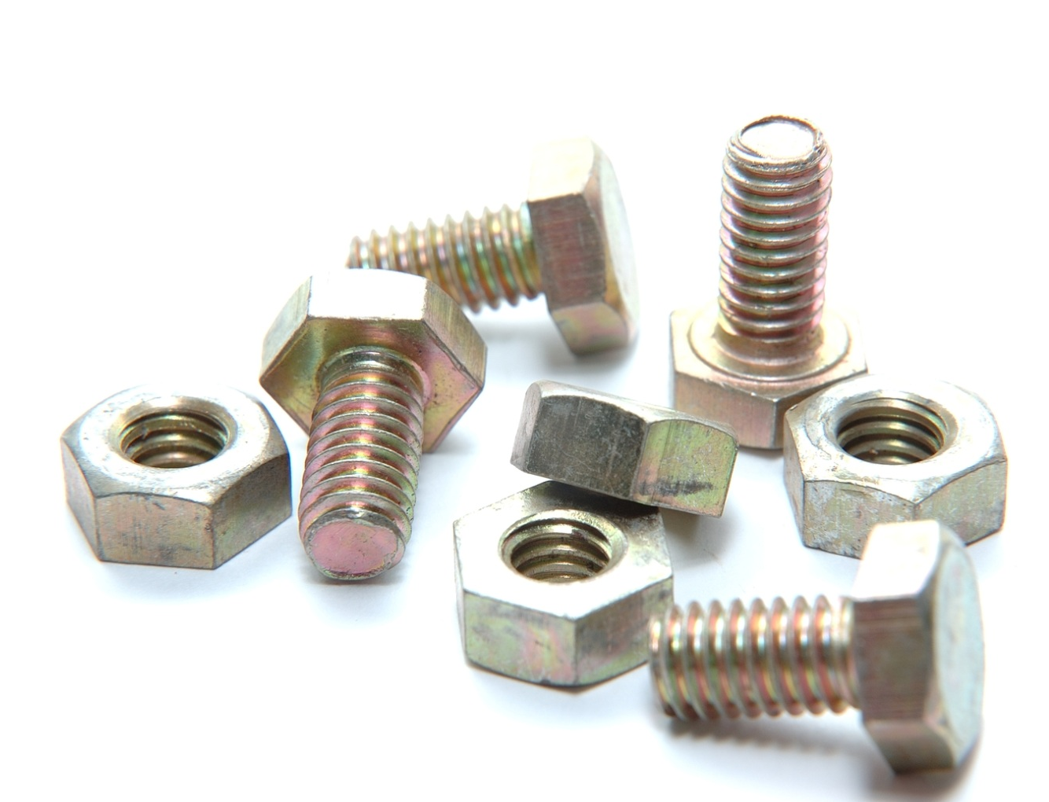
Transportation Investment Act
10 counties
One cent sales tax for 10 years
$8.5 billion raised
  85% regional projects
  15% local projects
100% return
Notes:
Here are the nuts and bolts of the Regional Transportation Referendum:
The General Assembly passed the Transportation Investment Act in 2010.
The law divides the state into 12 regions. Each region has the opportunity to vote for or against the referendum.
The referendum would provide the 10-county Atlanta region with a 10-year, 1 percent sales tax for transportation improvements.
100% of the revenue raised in the Atlanta region will stay and be invested in the Atlanta region.
The tax cannot go beyond 10 years and stops early if projected revenue is collected.
The state estimates that the Atlanta region would generate roughly $8.5 billion during that time.
85% of that revenue is used to fund regional projects.
The other 15% will be divided up among the local governments around the region for local projects.

Slide 12
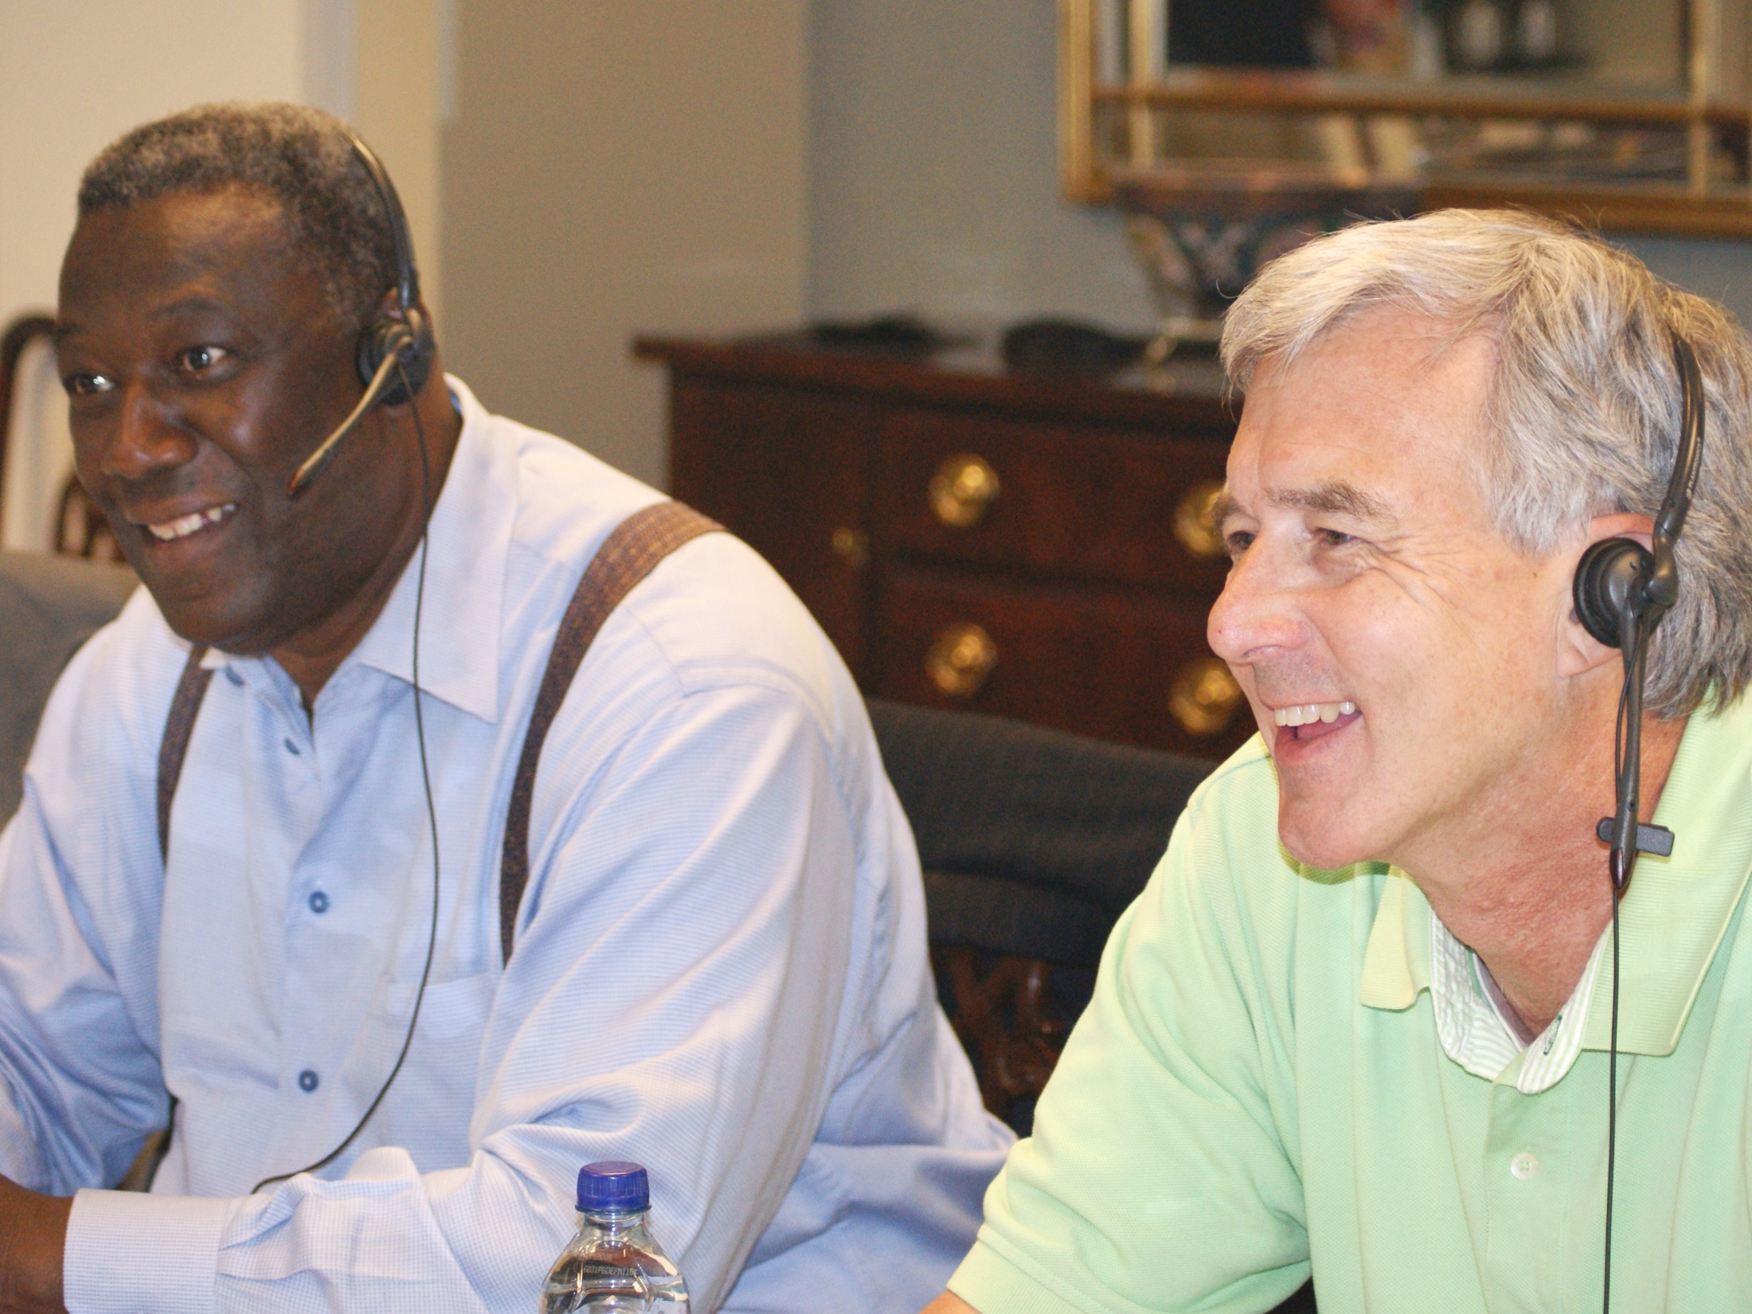
Transparency and Accountability
Notes:
A Regional Transportation Roundtable, composed of local officials from the 10-county region involved more than 200,000 residents in selecting the 157 priority projects to fund through the regional transportation referendum.
If the referendum is approved, the law calls for creation of a Citizens Review Panel made up of residents of the Atlanta region.
This panel will monitor the progress of the projects, as well as the spending, and report to the Legislature once a year.

Slide 13
Referendum Accelerates Implementation
Transportation Funding 2013-2022
Referendum Projects
$8.5 billion
70 percent ($9.24 billion) maintains existing network
$13.2 billion
RTP/TIP Planned Projects
$13.2 billion
Total = $21.7 billion
Notes:
Without the Regional Transportation Referendum, there will be about $13.2 billion in transportation investment during the next 10 years from traditional sources, like the Federal Highway Trust Fund.
But most of that money – about 70% - will be spent to just keep our existing transportation system in good condition.
With the referendum revenue, transportation investment could increase an additional $8.5 billion -- to $21.7 billion, an increase of 64 percent.
Bringing transportation improvements on-line sooner saves money in the long run. and addresses traffic congestion sooner – rather than having to wait 20-30 years for some of the projects on the list.

Slide 14
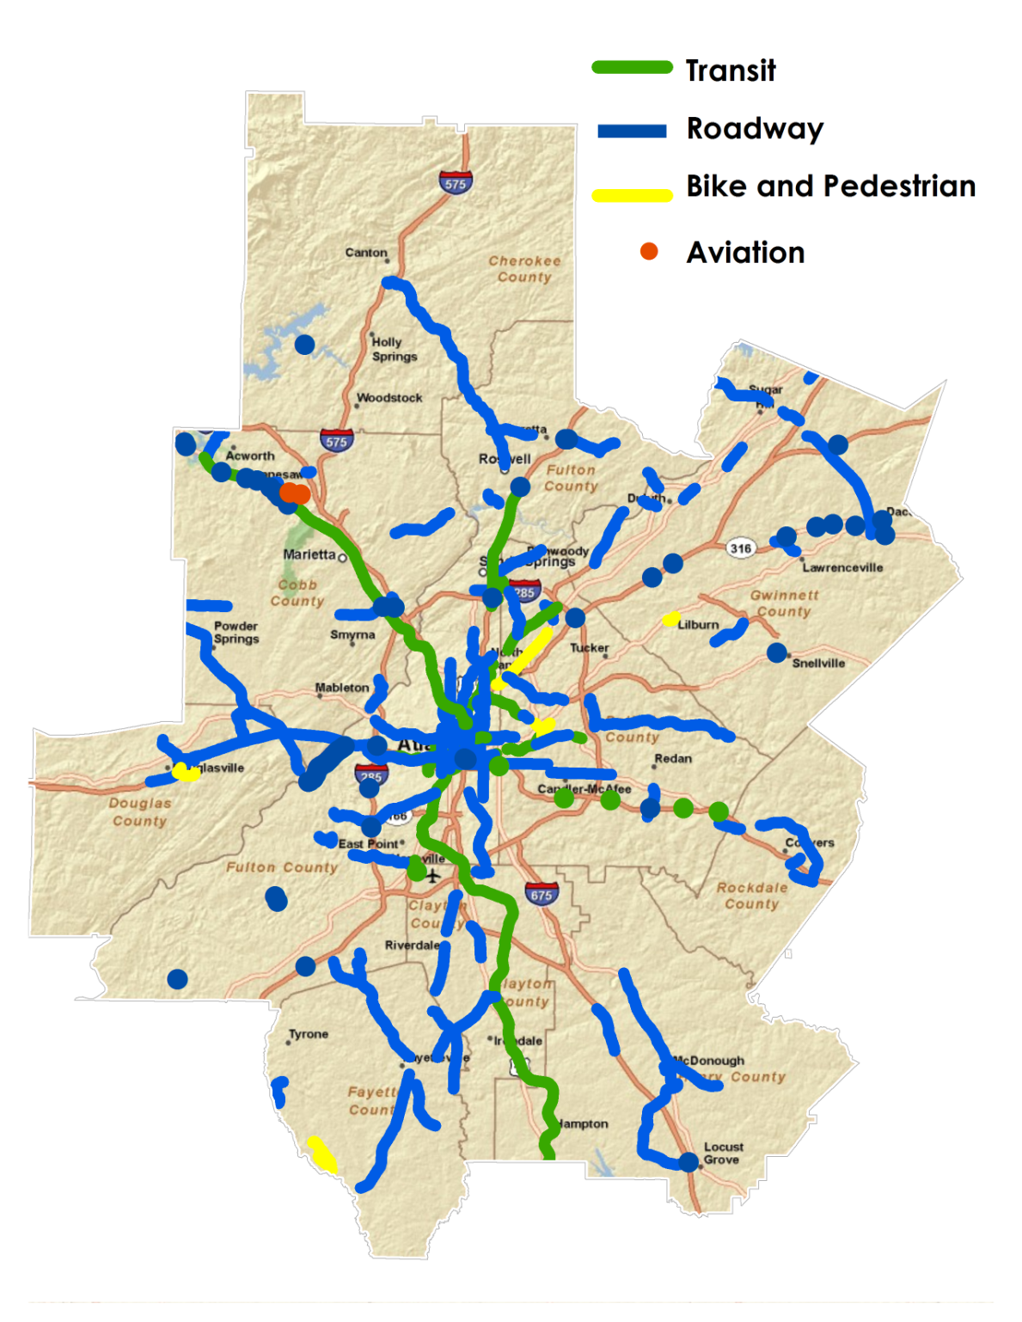
$8.5 billion
$7.2 billion for 157 projects
$1.3 billion for additional local improvements
Notes:
What projects are in the Referendum?
The referendum would fund 157 projects all around the region that include:
57 miles new rail and bus rapid transit
14 major interchange repairs
165 miles new and/or expanded roadways
Miles of new sidewalks and multi-purpose trails. Including the miles of additional sidewalks that will be built, enhanced or repaired as part of road projects.
In short, there is something on this list that helps just about everyone.
$3.73 billion to transit. Includes expansion and improvements to existing systems.
$3.43 billion to roadway expansion and operations.

Slide 15
Agency Role in Project Completion
GSFIC
GRTA
(Transit - Atlanta Region)
GDOT
(Road /Other - Statewide)
Tax Collection
Program Management
Dept of Revenue
Financial
Project Delivery
Local
MARTA
Consultant
Local
Consultant
GDOT
Regional Commissions
Source: Georgia Department of Transportation, February 2012

Slide 16
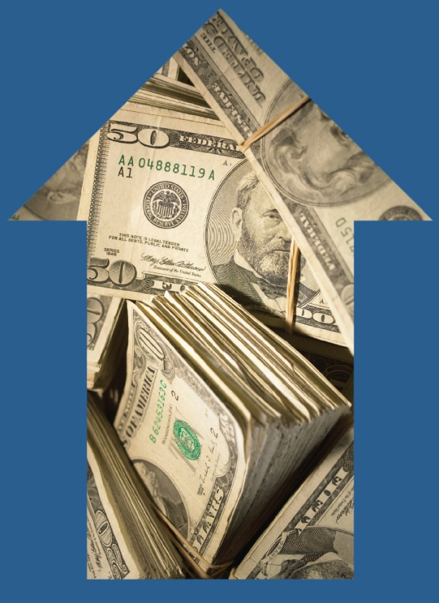


Economic Benefits
200,000 jobs supported
$34 billion impact on regional GDP
$18 billion rise in personal
income
Notes:
So, what impact could construction of the projects in the referendum have on our region?
ARC has spent several months analyzing the projects and meeting with regional and state economists to determine the economic benefits of building these projects.
Findings show that by 2040, ARC conservatively estimates:
Some 200,000 jobs will be created and/or supported by constructing these projects and realizing their ripple effects. This includes jobs that will be created by the actual construction projects, perhaps a more immediate shot in the region’s economic arm. But, also jobs that are sustained year after year.
Our regional gross domestic product will increase by $34 billion.
Because many of the jobs created and supported will be high-paying jobs, personal income in the region will increase by $18 billion.

Slide 17
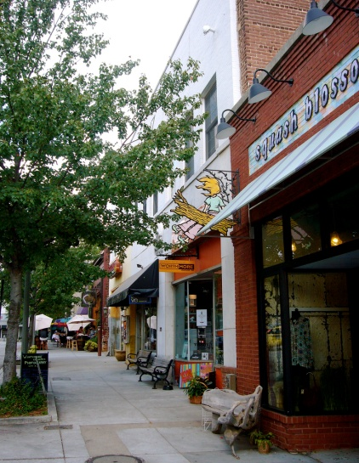
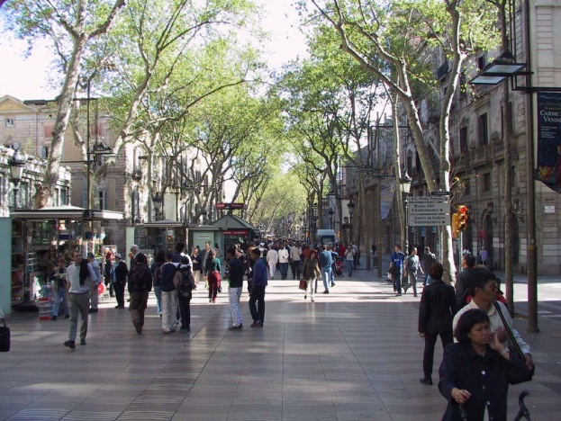
Economic Development
Notes:
A public transportation system that is properly planned and accommodated by land-use and transport policy has the ability to promote and increase economic development. Transit has the ability to create activity centers, providing development opportunities. Most importantly to Atlanta, transit also provides an alternative mode of transportation, potentially removing cars from the road and making our roadways and ultimately our lives more efficient.
4-to-1 return on investment
In spending approximately $8 billion for more than 150 projects,
the region receives more than $34 billion (current $s) back in
Gross Regional Product by 2040. (Gross Regional Product is the
Gross Domestic Product for the Atlanta region.)
$18 Billion increase in
region’s personal income
Due to increased travel time savings and reduced fuel costs,
regional residents will save a combined total of more than
$18 billion (current $s) by 2040.

Slide 18
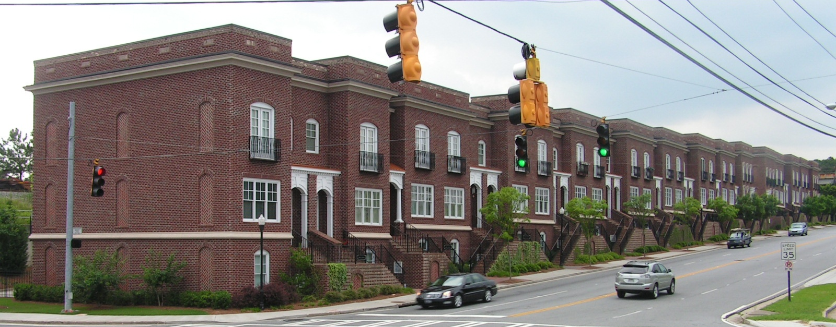
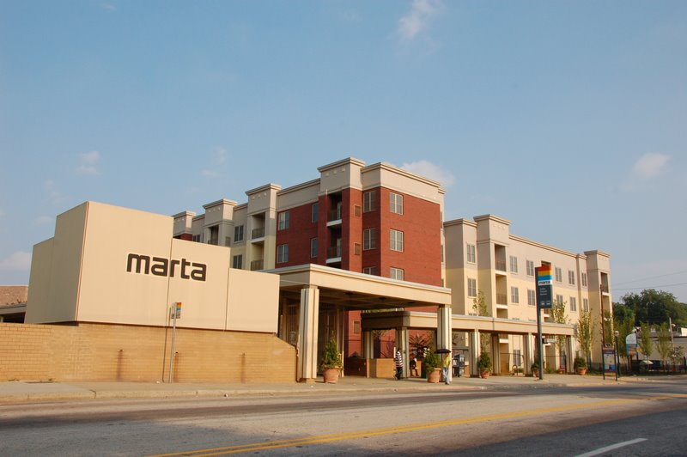
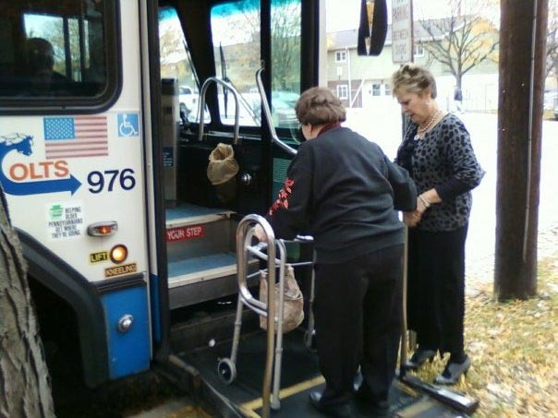
Housing Near Transit
Notes:
Transit investments can lower housing and transportation costs by expanding housing opportunities near transit and giving people more options to reach different locations. Improved access to transit becomes even more important as gas prices rise, disproportionately affecting low-income people.
A typical household in the Atlanta region with a median income of $58,390 spends an average of
$14,305 in transportation costs annually. That’s $1,192 per month, ranking Atlanta 44th out of the
nation’s 51 largest metros.
Working families in the Atlanta region with incomes between $20,000 and $50,000 spend 61 percent of their yearly budget on housing and transportation costs.
Certain land use and financing strategies can help ensure affordable housing near transit. Concurrently, increased property and land values generated by public investment in transit can be captured to assist with investments in critically- needed mixed-income housing.
As the majority of Baby Boomers “age in place” in suburbs and exurbs throughout our region, the number of non-driving seniors with limited mobility options is expected to continue growing rapidly.
By 2015, 90 percent (503,543) metro Atlanta residents 65 and older will live in communities where public transportation service is poor or non-existent, making Atlanta the worst large metro area (over 1 million residents).

Slide 19

Over $9 billion saved
Notes:
These projects will bring congestion relief and thereby grow the economy.
Over $9 Billion will be saved in wasted fuel and time by 2040.
There will be a 24 percent average decrease in future travel delays through TIA road widenings, new construction and improved interchanges.

Slide 20
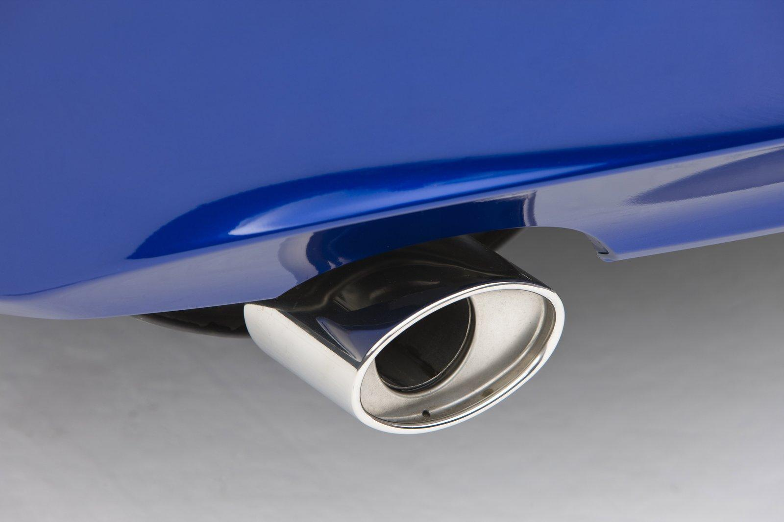
Saves fuel
1.2 million fewer pounds of tailpipe pollution daily
Notes:
These combined projects would reduce vehicle emissions by 600 tons, or 1.2 million pounds, each day.
That’s like taking 72,000 cars off the road every day.

Slide 21

Notes:
This leads to cleaner air for all of us.
Especially for groups like children and seniors, who are more at risk for asthma and other respiratory illnesses.

Slide 22
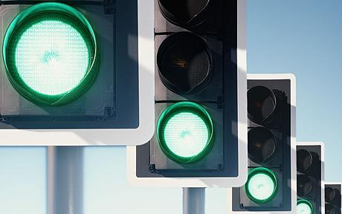
More efficient roadways
Notes:
We often only think of congestion on interstates. But, how many of you pulled out of your driveway and straight onto an entrance ramp? It doesn’t happen that way.
Some of our worst congestion occurs on the key surface streets that get us from our neighborhoods to the freeways to other destinations in our region.
Roadway operational projects are a significant part of the projects included in the referendum proposal:
45 projects
Include retiming signals, implementing smarter systems that can adjust to changing traffic conditions
These project types are among the most cost-effective congestion relieving strategies, typically resulting in about a 15 percent reduction in delays.
However, some of the region’s local governments have reported travel time savings of up to 40%

Slide 23
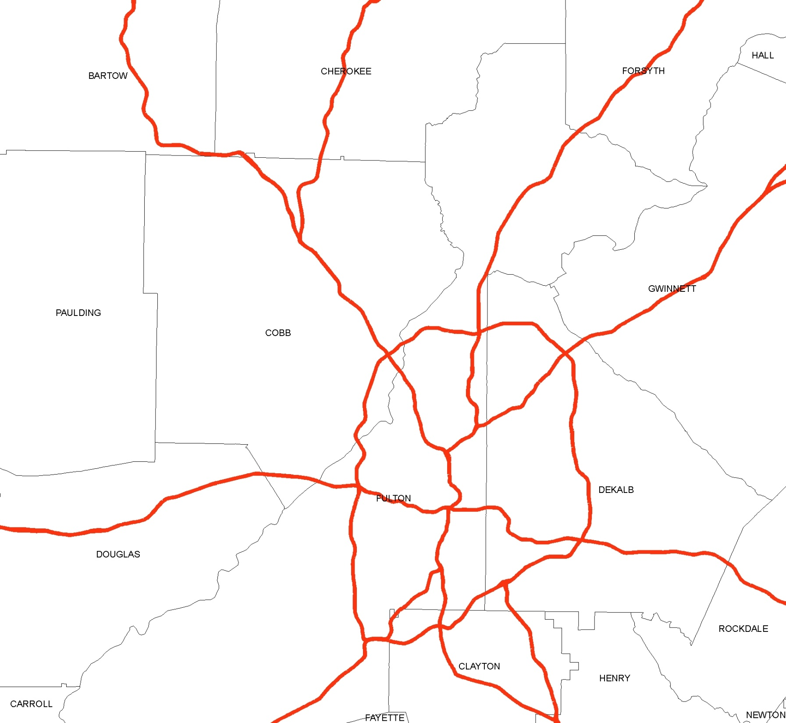
Better access to jobs by car…
45 Minute Car Travel Shed from Cumberland
117,000 more workers
With TIA
Without TIA
Notes:
Most importantly to our mobility and our economy is that as a result of constructing these projects, more potential workers will be able to reach the region’s major employment centers.
Developers and major employers look at 45 minutes is the “magic number” for employers’ commuting time when it comes to their ability to attract and retain employees.
What you see here is a map that shows how many workers can reach the Cumberland Galleria area in 45 minutes or less today (in blue) vs. after the project list is completely built (in red).
As you can see, a lot more potential employees, about 117,000 more, could reach the home of Home Depot, Coca-Cola Enterprises, The Weather Channel and other major employers, in 45 minutes or less.
Making these areas more accessible to more people attracts new employers who need that convenient talent pool to draw from.

Slide 24
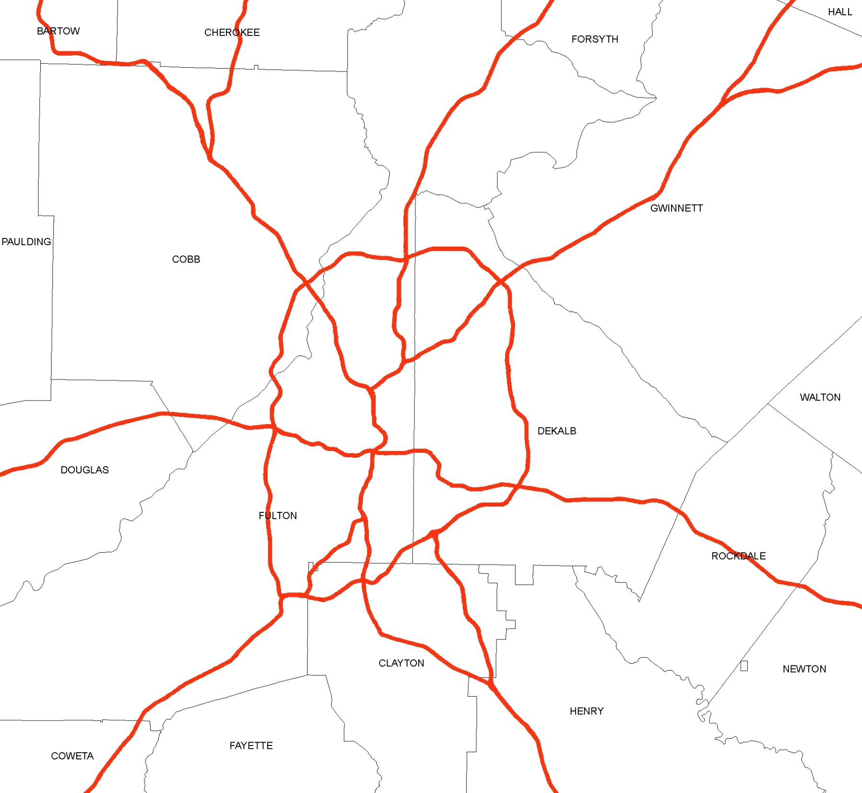
…or by transit
45 Minute Transit Travel Shed from Emory/CDC
223,000 more workers
With TIA
Without TIA
Notes:
Expansion of existing transit and the creation of new lines will put even more workers within reach of employment centers by transit, as well.
ARC estimates that some 223,000 more potential workers could reach one of the region’s largest employment centers, the Emory/CDC/Clifton Corridor area by transit than can do so now.

Slide 25

What will it take for our region to stay competitive?
Notes:
You’ve heard a lot of facts and figures, but it really boils down to how to keep our Atlanta region competitive.
Many other metro areas around the U.S. and the world have chosen to pursue funding their transportation needs through referendums similar to this to enhance their future competitiveness and mobility.

Slide 26
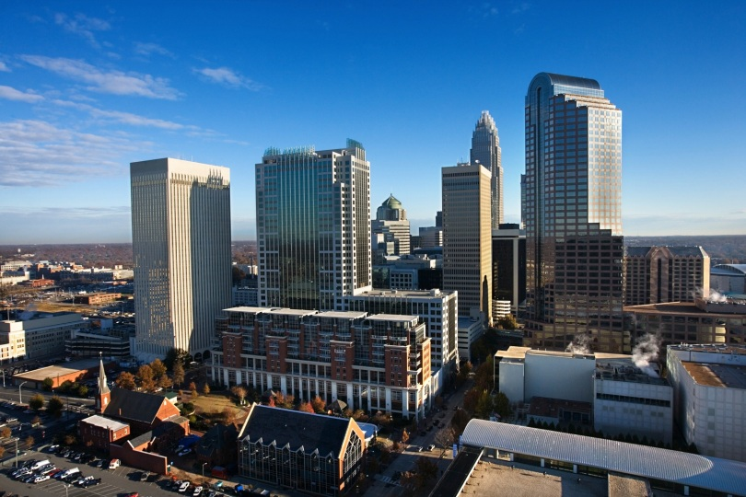
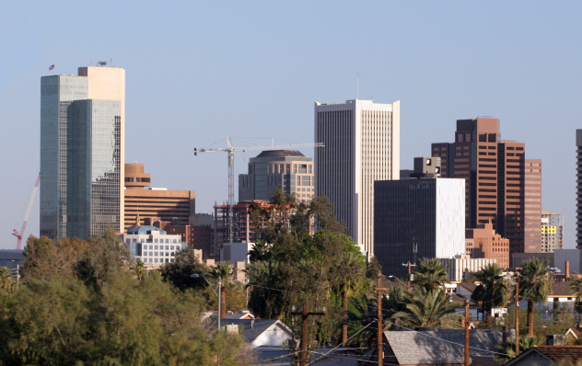
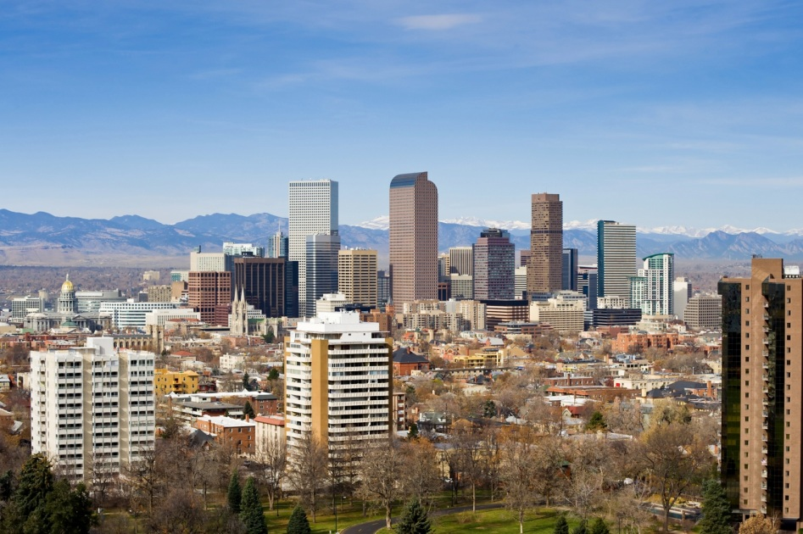
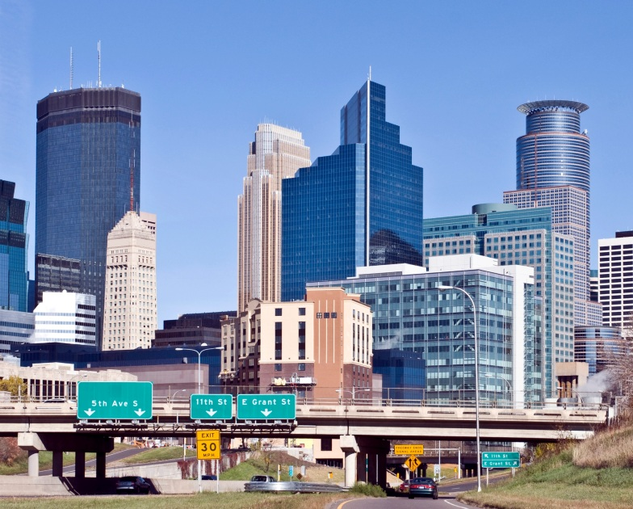
Charlotte
Phoenix
Denver
Minneapolis
Notes:
Metro regions like Dallas, Denver, Phoenix, Charlotte, Minneapolis and Seattle, have passed sales tax referenda in the past few years and are already investing in and building new transportation systems.
In deciding whether to fund metro Atlanta’s transportation needs through the Regional Transportation Referendum, we should keep in mind that while we’re making this big decision here in metro Atlanta, similar decisions are being made all across the U.S.

Slide 27

Notes:
So -- What choice will voters have to make?
Is it worth about $100 a year per household to fund the projects needed to improve our transportation system?
Is it worth paying an additional one cent sales tax to advance transportation solutions in the next 10 years, rather than waiting up to 30 more years for some?
We know that:
Our metro area will continue to grow and our traffic congestion will increase.
We must make improve our transportation system in order to keep up with our competitors.
Infrastructure investments will boost to our economy and save us time and money.
All of us want less time on the road and more time at home with our families.
You do have an important choice to make. Please vote on July 31st.

Slide 28
REGIONAL TRANSPORTATION REFERENDUM
JULY 31, 2012
www.atlantaregionalroundtable.com
Notes:
I will be happy to take any questions you have.

Slide 29
Plan A
Transportation Investment Act of 2010
AKA HB 277

Slide 30
Project Delivery
GDOT and GRTA are authorized to determine whether a project should be designed and constructed by the Department, by a local government, or by another public or private entity. It is anticipated that intergovernmental agreements will be needed during the delivery of the project lists.
Working on RFP for Program Management. Anticipate advertising in spring 2012.

Slide 31
GDOT Getting Ready to Deliver
July 31, 2012 Referendum
Program Governance
Program Setup
Program Delivery
Program Initiation
Program Closure
Pre-Program Preparation
4Q 2011
1Q -3Q 2012
4Q 2012
2013 – 2022
2023+
Program Charter
Program Management Plan
Implement Program Management Plan
Monitor & Control
Close out program

