Slide 1
Enabling Transit Solutions
Open Transit Data for the Atlanta Region
February 29, 2012
Regional GIS Users Group Meeting
Transportation Division
Regan Hammond, Landon Reed

Slide 2
Who is familiar with Open Data?

Slide 3
Topics Discussed
Select Issues in Transit
What is Open Transit Data?
Regional Transit Data Warehouse
Open Data and Innovations
Case Study Observations

Slide 4
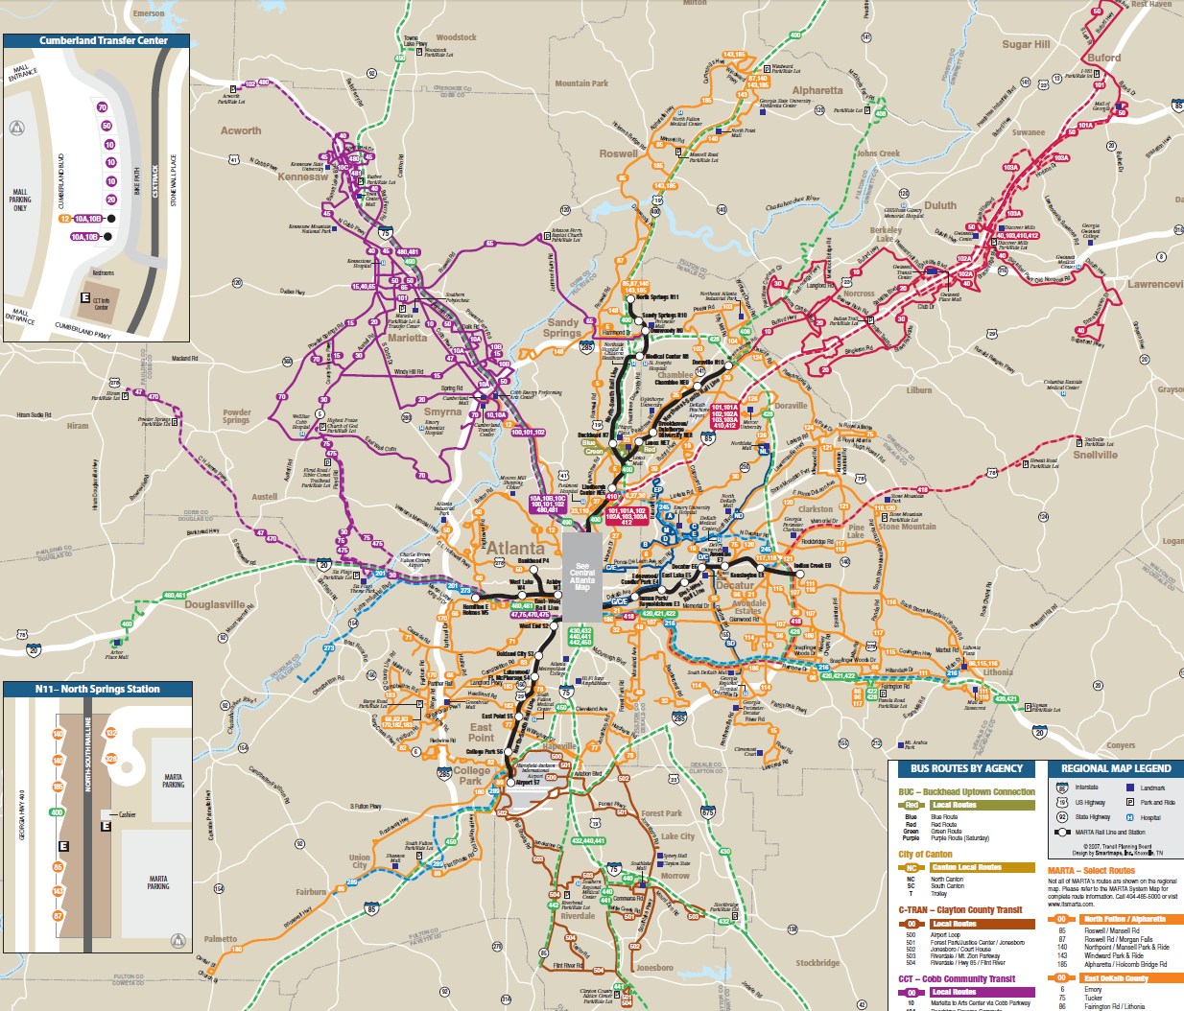
Disconnected regional transit system
Regional
Connectivity
Cost
Effectiveness
Information
Equity
Land Use
Impacts
Notes:
More than five agencies shown on this regional transit map, all in different colors
To make trips using multiple transit providers, riders must acquire full time tables for each leg from a different agency or website
Even though riders can use one fare card on all major providers, planning a multi-agency journey is challenging

Slide 5
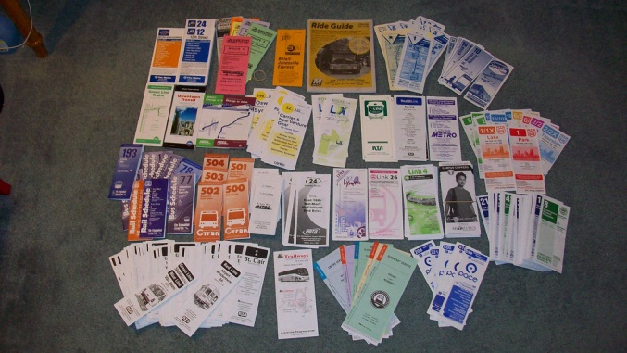
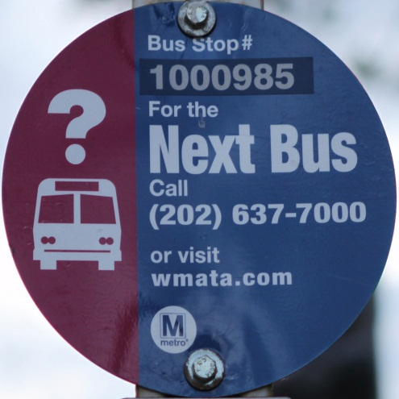
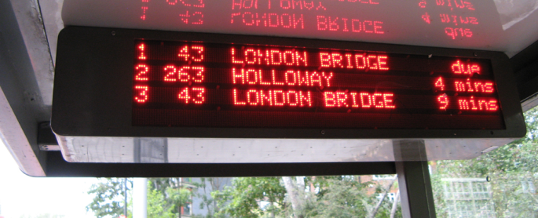
Costly Information Delivery
Custom Schedules per Route
Hosting Phone Number
Flickr/TheTransitCamera
Flickr/Cubcake Photography
Electronic Signage
Flickr/BristolRE2007
Regional
Connectivity
Cost
Effectiveness
Information
Equity
Land Use
Impacts
Notes:
Providing any kind of information to riders is a cost to the transit agency
Call-in numbers and electronic signage have high costs to the agency

Slide 6

Equitable Information Access
Personal Technology Limitations
Considering All Abilities/ADA Access
Regional
Connectivity
Cost
Effectiveness
Information
Equity
Land Use
Impacts
Notes:
Information from agencies should not be limited to those with specific devices
Agencies should provide information equitably to users with varying sensory abilities

Slide 7
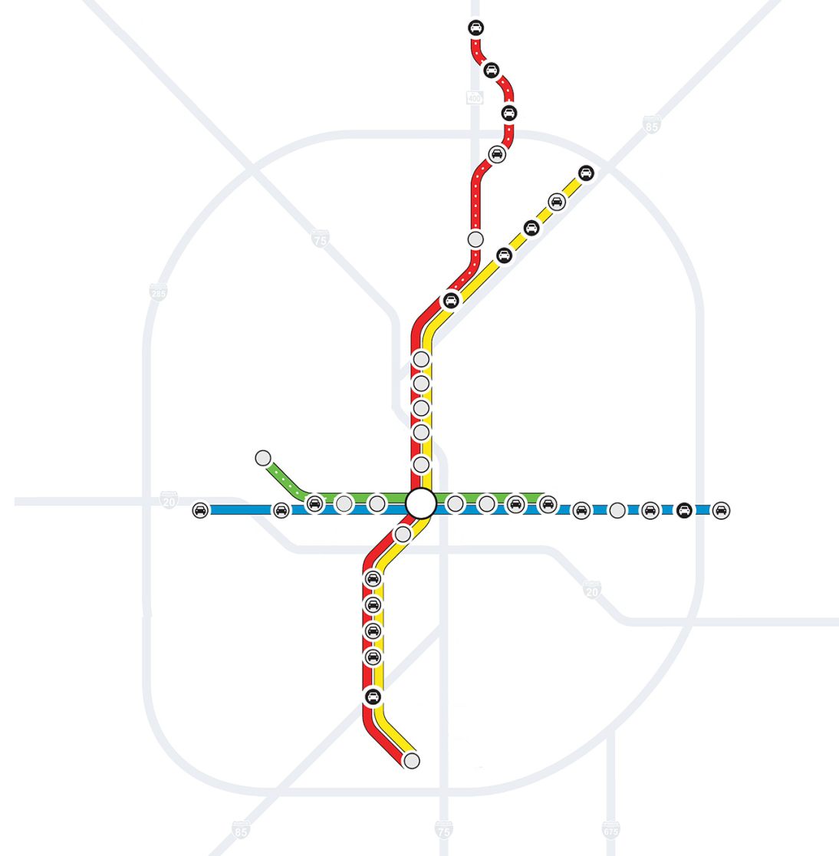
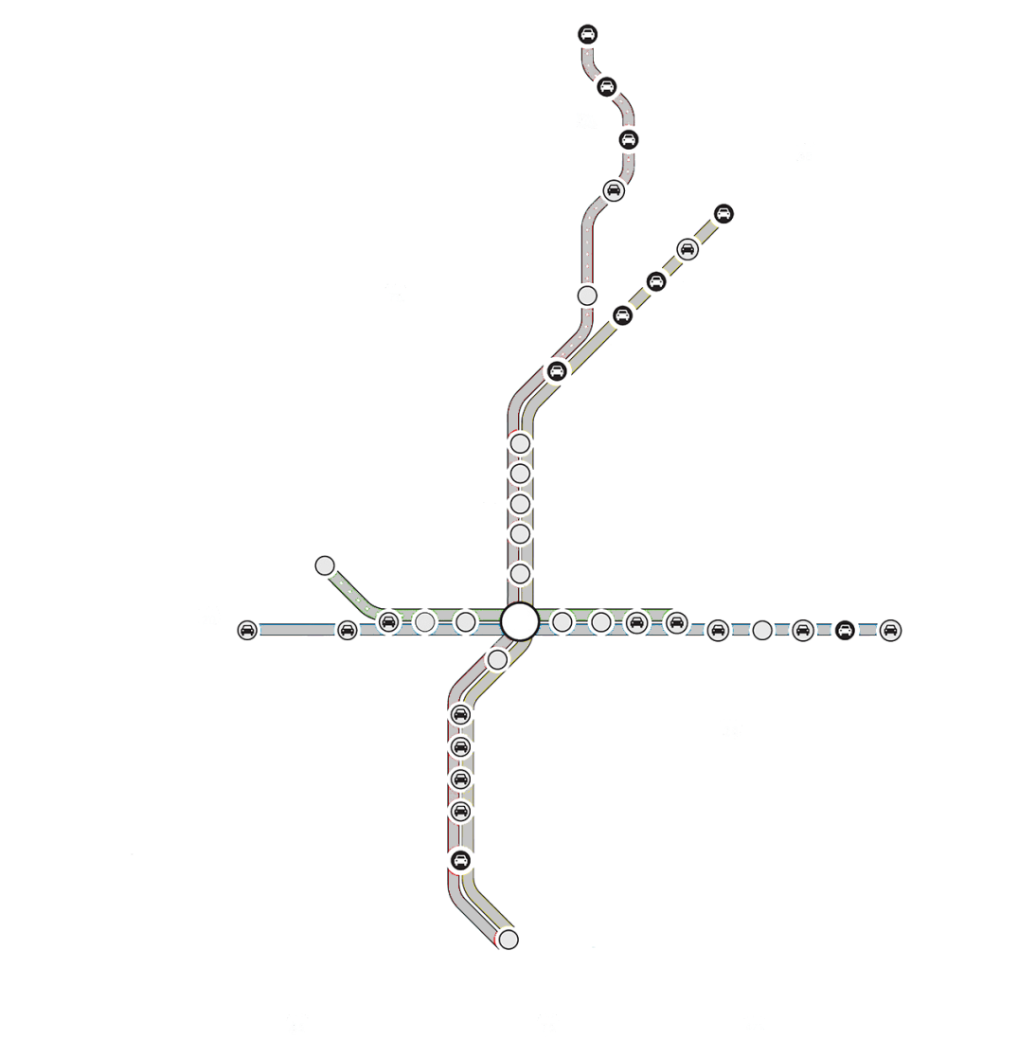
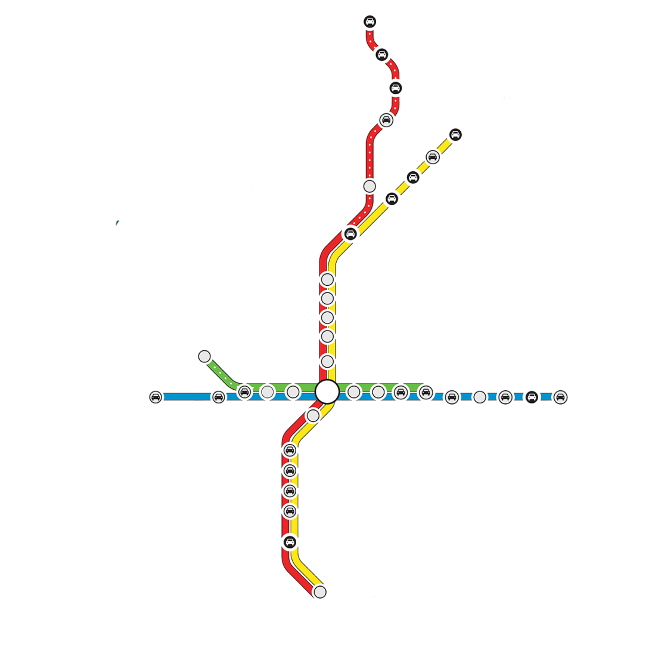

Impacting Land Use/Mode Choice
We all know where we live in relation to the freeway.
What if you knew
more about transit?
Regional
Connectivity
Cost
Effectiveness
Information
Equity
Land Use
Impacts
Notes:
Many can identify with and orient themselves to where they live or work based upon the network of highways
Increased access to transit information could have impacts on land use in terms of housing location and mode choice

Slide 8



Evolution of Transit Data
Paper Schedules Digitization Interactivity
Schedule
10
9:36
Notes:
Initially paper schedules provided users with an overload of information in a format that could be difficult to read
Next, the paper schedules were digitized through the use of a pdf or integrated into a web page with no substantive change in format
Moving further, developers and agencies began to deliver this information through interactive applications that give riders user specific information

Slide 9
How does Open Data help?
Transit Agency
Agency produces data and opens it once.
Agency responds to
individual, special requests by developer
DATA
Anyone can access data
App Developers
Riders
Small subset of riders find this specific tool useful.
Many riders access a diverse market of tools powered by GTFS.
Notes:
In the traditional model, an agency responds to many different developers’ custom requests for information. It only allows for a small set of developers reaching a small subset of riders.
With the open data model, an agency proactively puts data out and anyone interested in the data can use it as they see fit. Open data model allows for more developers to participate for a larger and more diversified market for applications.

Slide 10
Developer Perspective
Data
Hub
Notes:
In the traditional model, developers must reach out to multiple agencies to work on a collaborative project, such as a regional transit trip planner.
In the open model, developer can better access information once agencies put their information in a data hub with other agencies’ information.

Slide 11
Developer Perspective
Standardized
Data Hub
Notes:
Developers still have to work with varied formats in which agencies provide their schedule information.
Having a standard format creates a common language which further removes barriers to app innovation.
The developer making a regional transit trip planner now has access to all data in a unified format.

Slide 12

General Transit Feed Specification (GTFS)
shapes.txt
routes.txt
agency.txt
trips.txt
stops.txt
stop_times.txt
calendar.txt
GTFS
Notes:
GTFS is a used as a standard in representing schedule and route information in the United States.
GTFS takes various schedule information like route and stop name and zips it into a file.

Slide 13
Regional Transit Data Warehouse
Enables regional approach to collection, management, and distribution of transit system data
  Performance
  Fleet & Facilities Inventory
  Operations
Supports ARC’s transit performance monitoring
Public interface to explore transit options through online, interactive map of regional system
Provides General Transit Feed Specification (GTFS) to third-party developers wishing to leverage available data

Slide 14
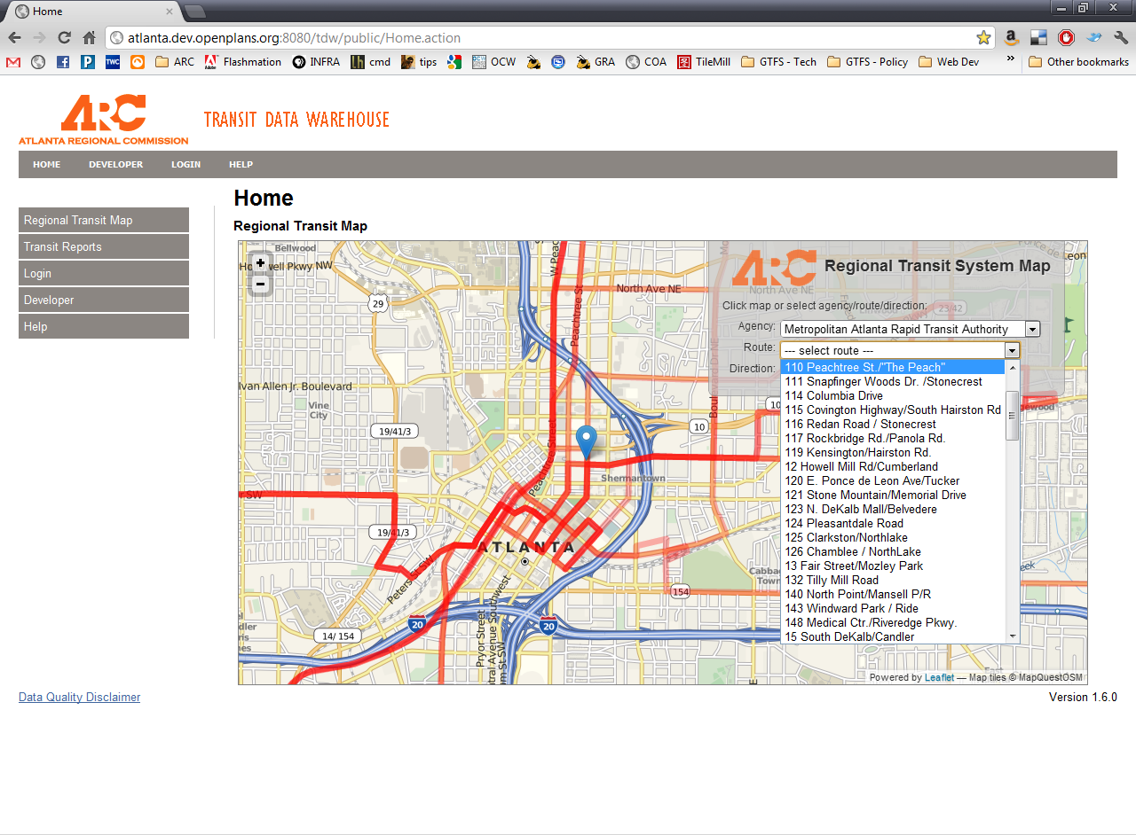
Transit Data Warehouse

Slide 15
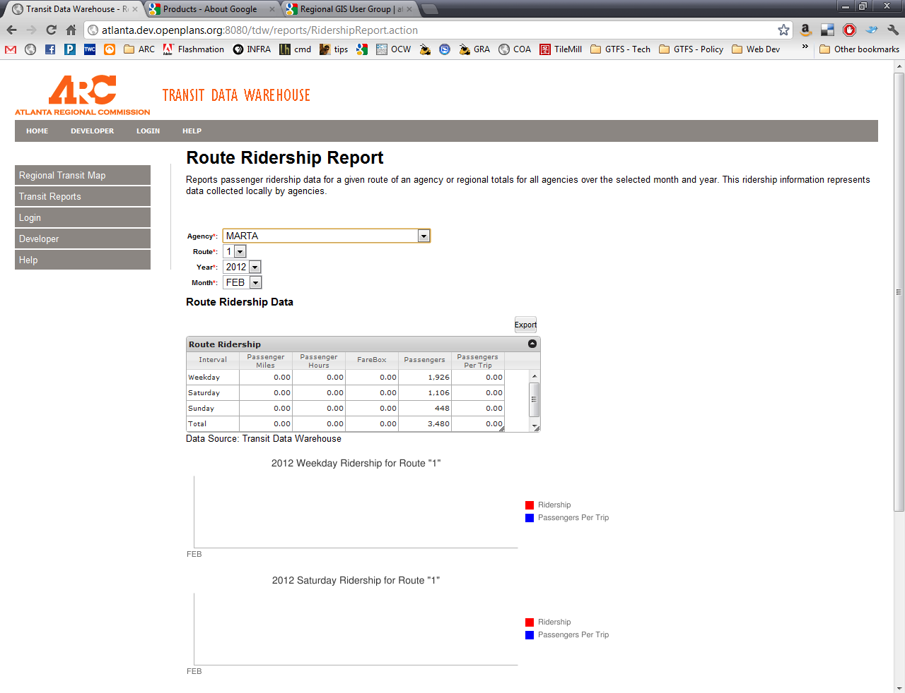

Slide 16
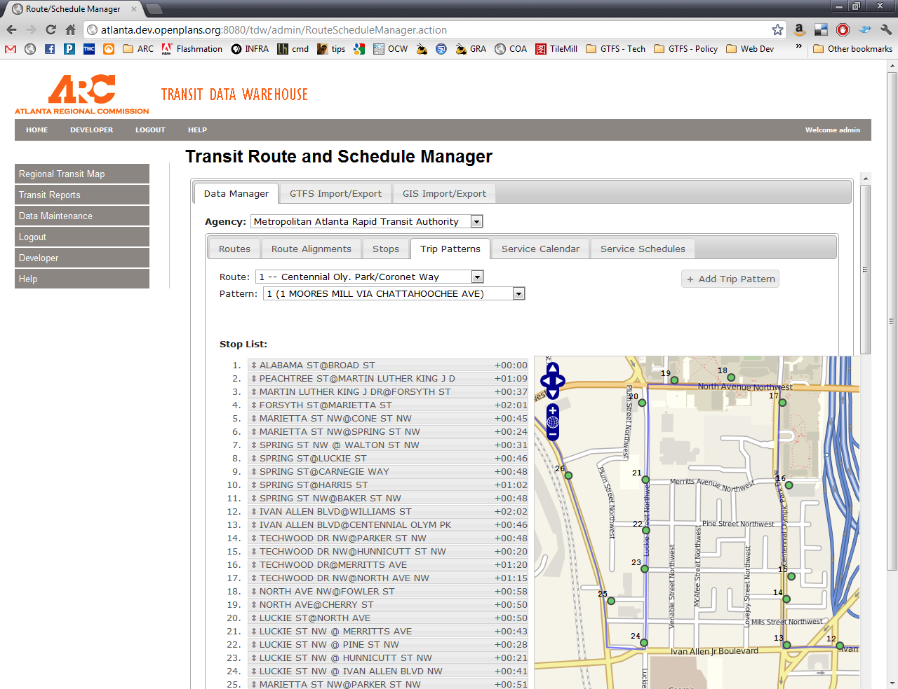

Slide 17
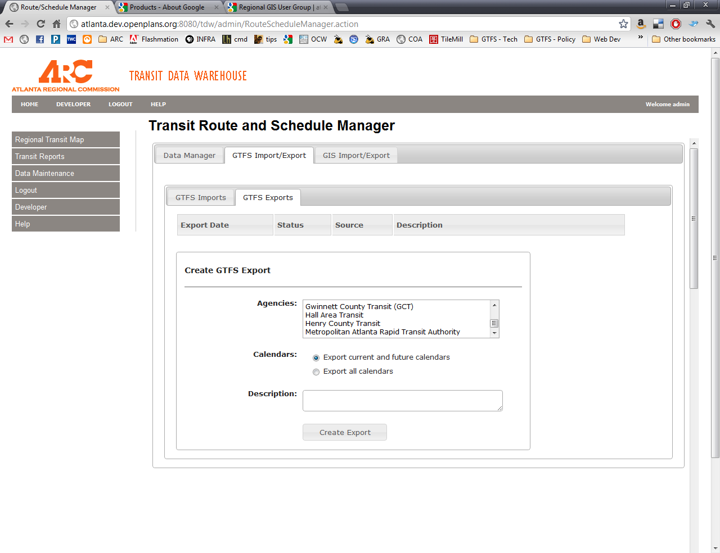

Slide 18
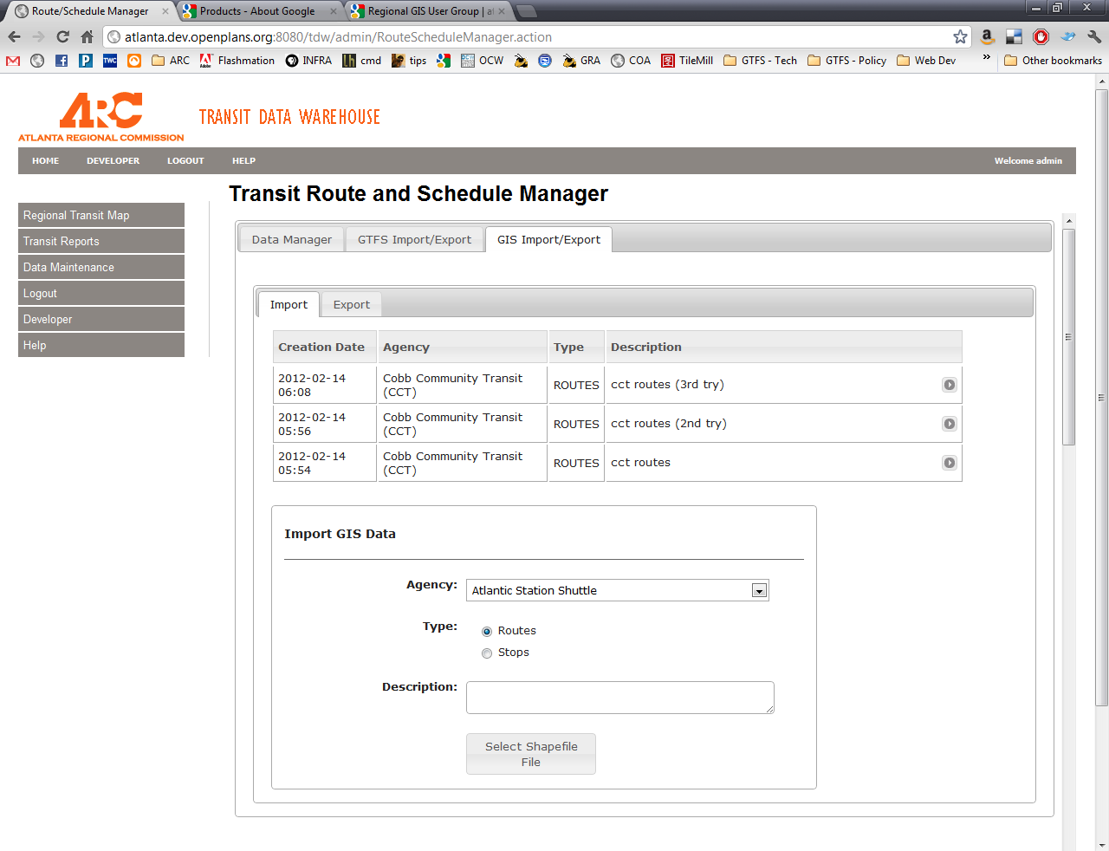

Slide 19
Government as a Platform
Public Transportation Agency:
  Safe, efficient transit operations
Data generated as a by-product of operations
Releasing data to developers empowers them to address certain issues they see.

Slide 20
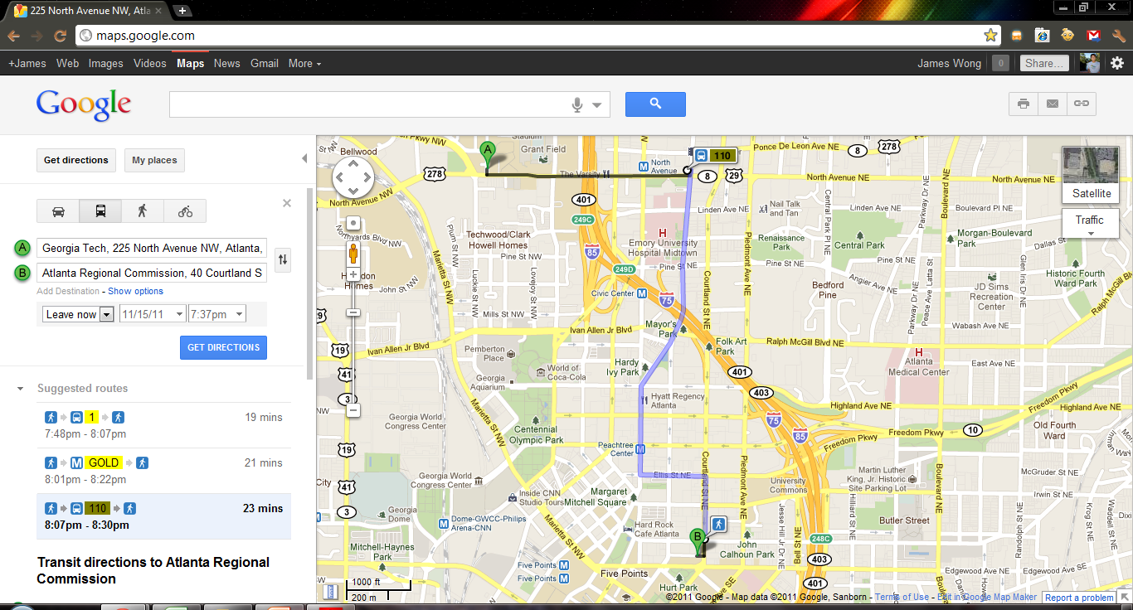
Google Transit
Sharing GTFS with Google allows Atlanta to show up on Google Transit
http://maps.google.com
Notes:
Although creating a GTFS puts transit agencies on the Google Transit system, opening the GTFS for anyone allows for the possibility of much more.

Slide 21
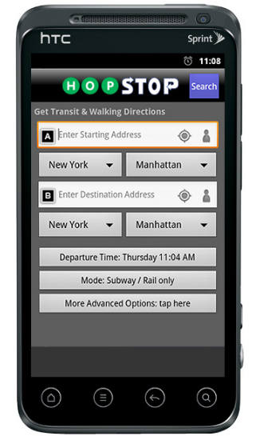
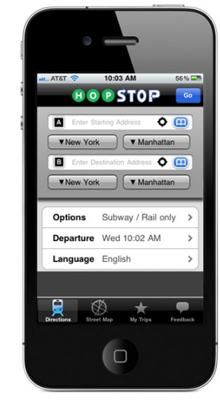
HopStop
Bus schedule in more concise and user-friendly format
Personalized schedule data based off user’s GPS location
Enables multi-agency trip planning
Highly popular nationwide application
Available for all major smart phone platforms
http://www.hopstop.com
Regional
Connectivity
Cost
Effectiveness
Information
Equity
Land Use
Impacts
Notes:
Puts traditional paper schedule in a personalized, easy to read format for the user
Orients information based on users’ current location

Slide 22
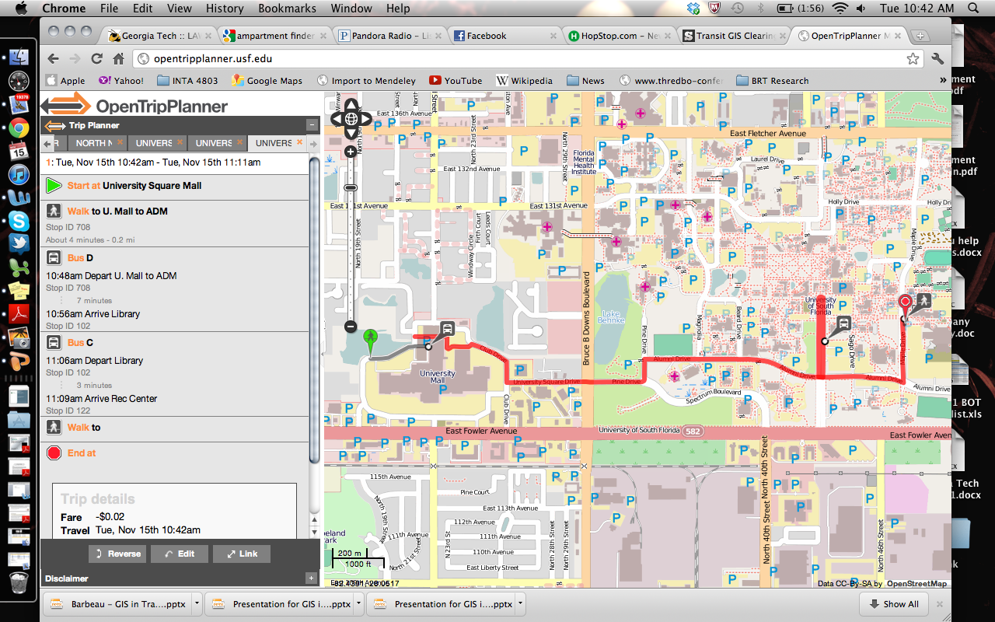
OpenTripPlanner
http://www.opentripplanner.com
Regional
Connectivity
Cost
Effectiveness
Information
Equity
Land Use
Impacts
Notes:
Multiagency tools such as OpenTripPlanner reduce the perception of a disconnected regional system
Encourages multimodal travel and provides users the necessary information to make informed trips
OpenTripPlanner can add cities with a GTFS feed in a short period of time and no cost to the agency

Slide 23
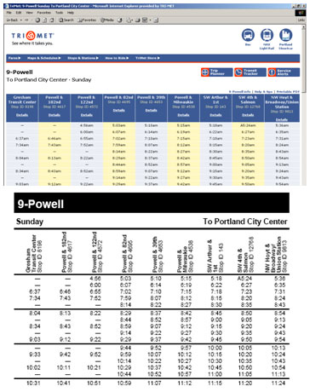
Direct Agency Benefits
TimeTablePublisher
  An application that runs exclusively on GTFS
  Produces print-quality schedules for all routes, directions
  Creates web-ready formats for agencies too
  No cost to the agency
  One of many open source tools
http://code.google.com/p/timetablepublisher/
Regional
Connectivity
Cost
Effectiveness
Information
Equity
Land Use
Impacts
Notes:
Benefits not just to the public, but also potential efficiency gains and saving for the agency
Allows production of stop-level, schedules for entire system
Other innovations that are created for GTSF format can quickly be adopted by agencies

Slide 24

Equity in Information Access
Agency sponsored information projects must be ADA compliant
Open data enables developers who specialize in accessible apps to access local market
  Interactive Voice Response (IVR)
  SMS Schedule Access
  Transit Assistive Devices (TADs)
Regional
Connectivity
Cost
Reduction
Information
Access
Land Use
Impacts

Slide 25
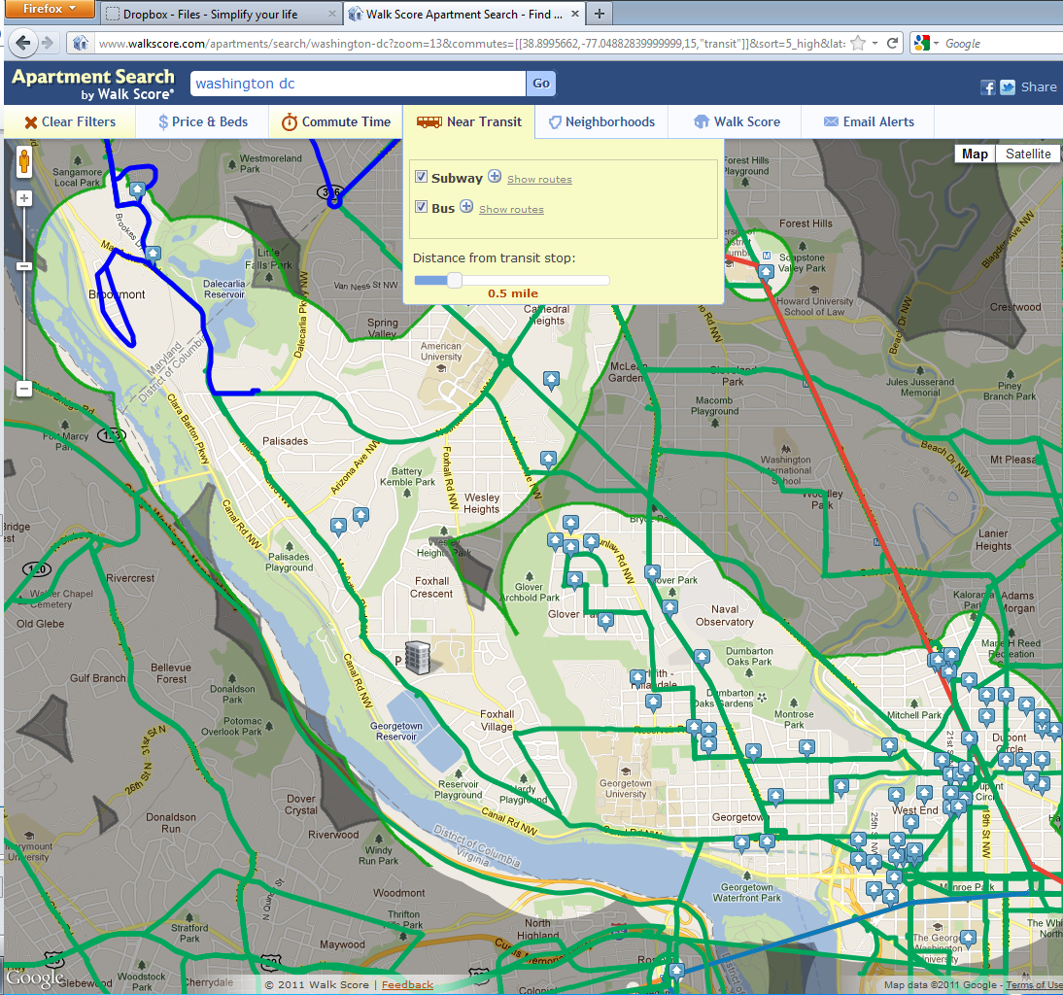
Walk Score: Apartment Search
http://www.walkscore.com
Regional
Connectivity
Cost
Reduction
Information
Access
Land Use
Impacts
Notes:
Tools like Walk Score: Apartment Search allow people to make more informed housing decisions based on urban mobility.
This map shows how far a person can live from a specific employment location for a 30 minute transit commute.

Slide 26
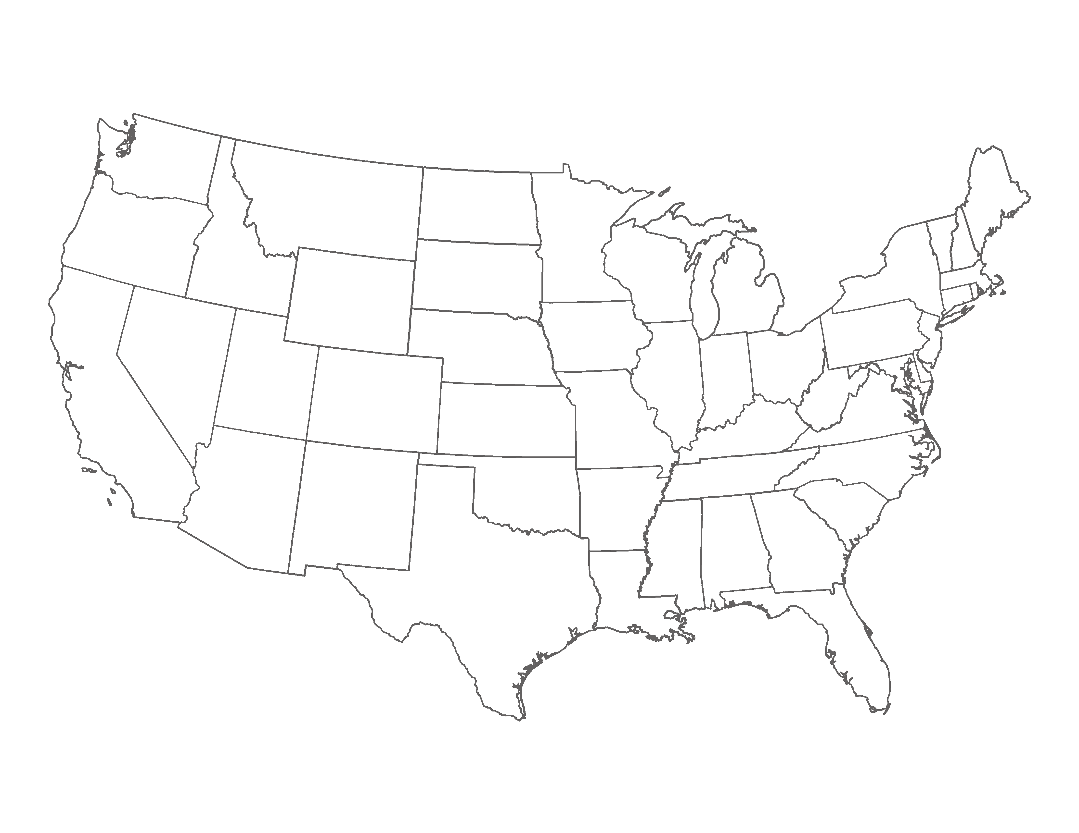
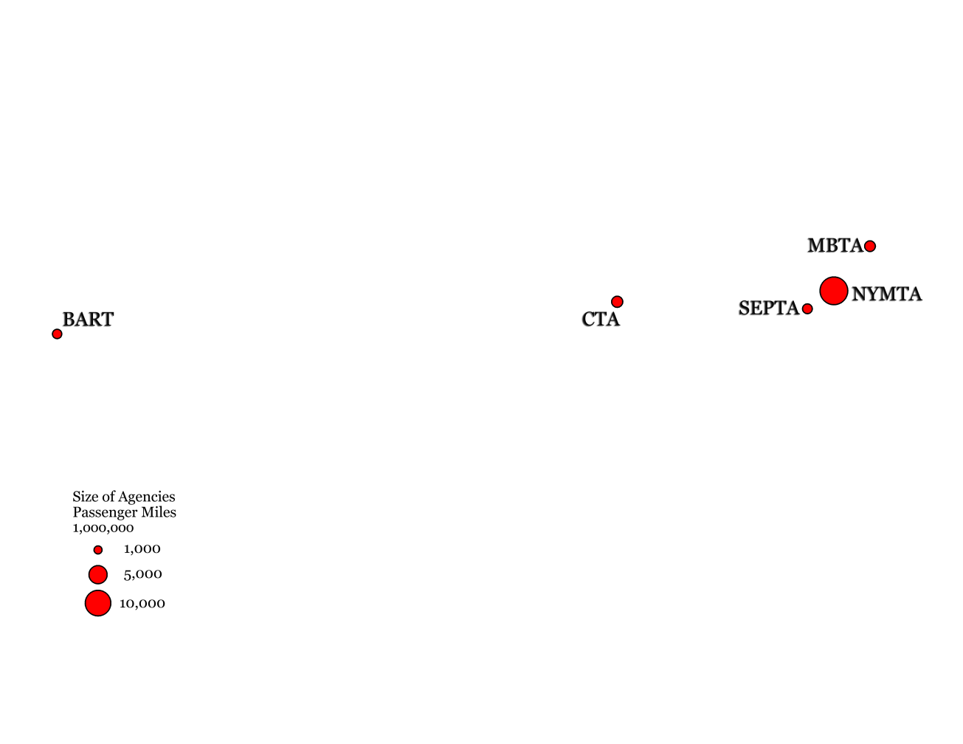
Case Study Approach
Transit Agencies
  Philadelphia
  San Francisco
  Chicago
  New York
  Boston
Email and phone interviews with staff

Slide 27






Development Cost Scenarios
Multiple Platforms: BART Experience
  Deployed apps for multiple devices
  Too costly to keep up with evolving technologies
Custom Solution: goroo
  Multimodal trip planner
  Only works in Chicago
  Costs >$4,000,000 to public
Open Source: OpenTripPlanner
  Deployed in Portland
  Estimated ~$140,000
Source: Biernbaum, Rainville, Spiro. Multimodal Trip Planner System Final Evaluation report (2011)

Slide 28
Key Lessons Learned
Open data should be accurate and up-to-date
  Transit riders will rely on the data
  Construction, closures, schedule changes should be updated.
Staff-level champions and strong leadership leads to successful deployments

Slide 29
Key Lessons Learned
Express agency concerns through usage agreements
  Logo and transit map usage
  Ensuring developers don’t misrepresent themselves or apps as “official”
Developer Relationships
  Different levels of engagement
  Support for mutual customers
Developers
Agencies
z
Transit Riders

Slide 30
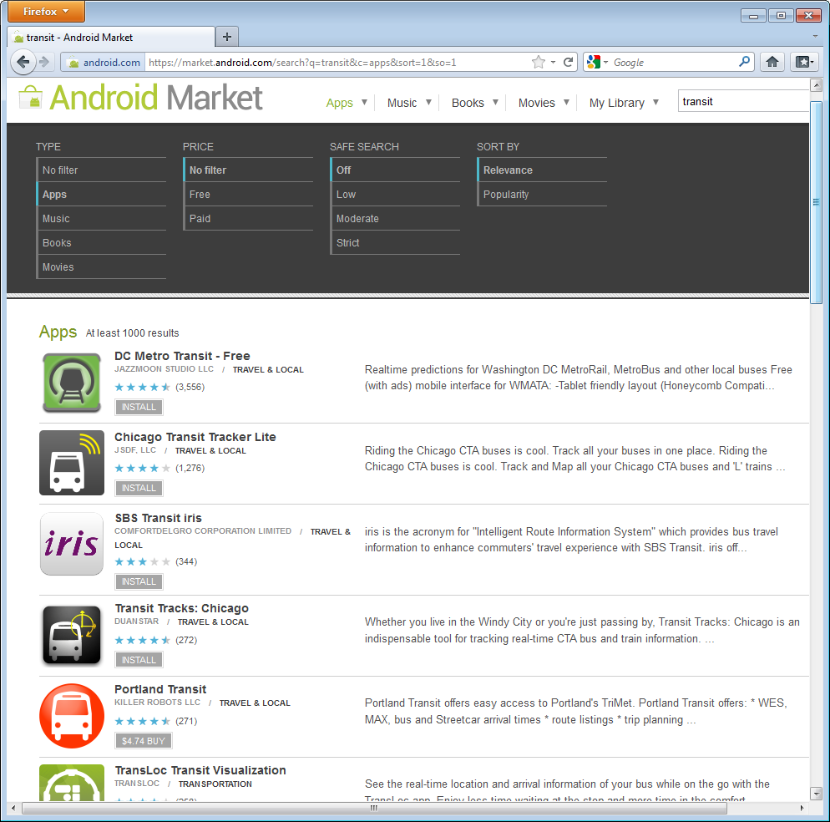
Performance Measures
Ways to track usage
  GTFS downloads
  App downloads
  Number of apps
  developed
App Accessibility Inventory
Market Research Surveys

Slide 31
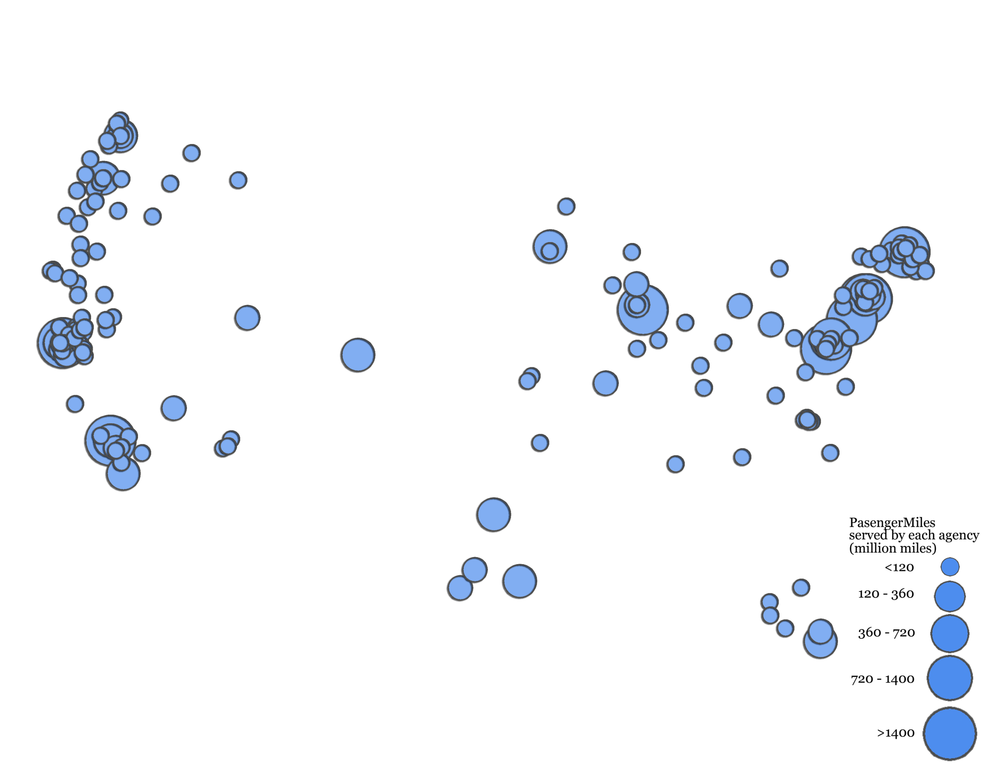
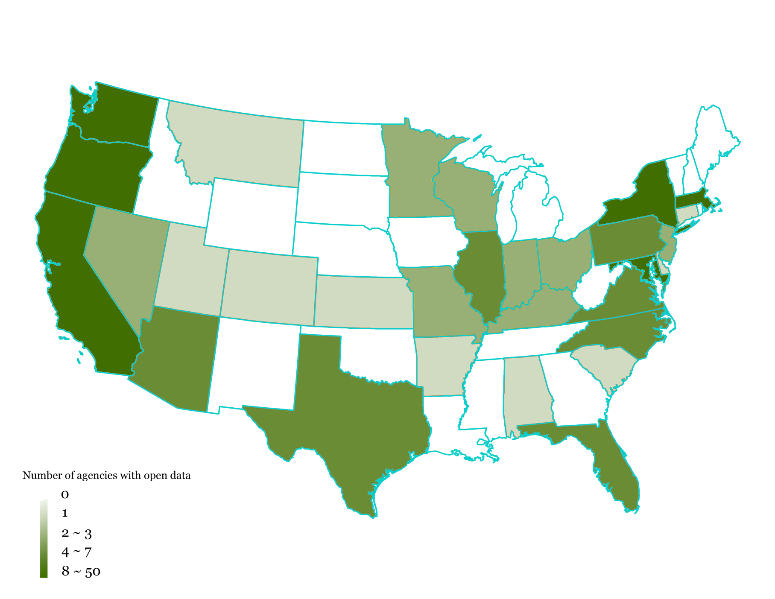
Where is Georgia in the Open Data trend?
Notes:
Georgia is a state where no transit agencies have open data (white). The darkest states have several agencies that have opened their data.
Both large and small agencies alike are able to successfully implement open data using GTFS.

Slide 32
Atlanta: State of the Region
No Atlanta transit agencies provide data in an open format … yet.
MARTA has a GTFS feed
  Provides to Google Transit and HopStop
  Not Open
Smaller agencies need to create and open feeds
ARC developed Regional Transit Data Warehouse
Successful discussion on open data with TOS & RTC

Slide 33
ARC: Moving Forward
Providing staff support for agencies
Deploy Regional Transit Data Warehouse
Continuing to advocate for open data
Hosting “hackathon” to encourage innovation and help address transit needs
  Looking at Summer 2012
  Collaboration with Georgia Tech

Slide 34
Contact Information
Regan Hammond Principal Planner
404.463.3269 | rhammond@atlantaregional.com
Landon Reed Transit Planning Intern
404.463.3283 | lreed@atlantaregional.com

