Slide 1
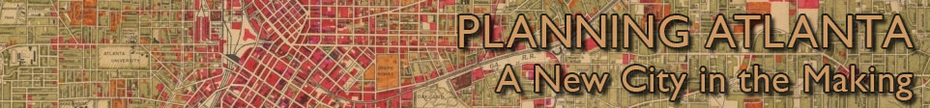
The Georgia State University Library Digital Collection, "Planning Atlanta: A New City in the Making, 1950s - 1980s"
Joe Hurley
Data Services, Geosciences, Gov't Info, Maps and GIS Librarian
Georgia State University Library
Atlanta, GA

Slide 2
Planning Atlanta Digital Collection
700 city planning maps
235 city planning publications and documents
All maps and publications from the City of Atlanta and the Atlanta Regional Commission
Most items are from the 1950s to the 1980s, however some are from the 1930s, 1940s and 1990s

Slide 3
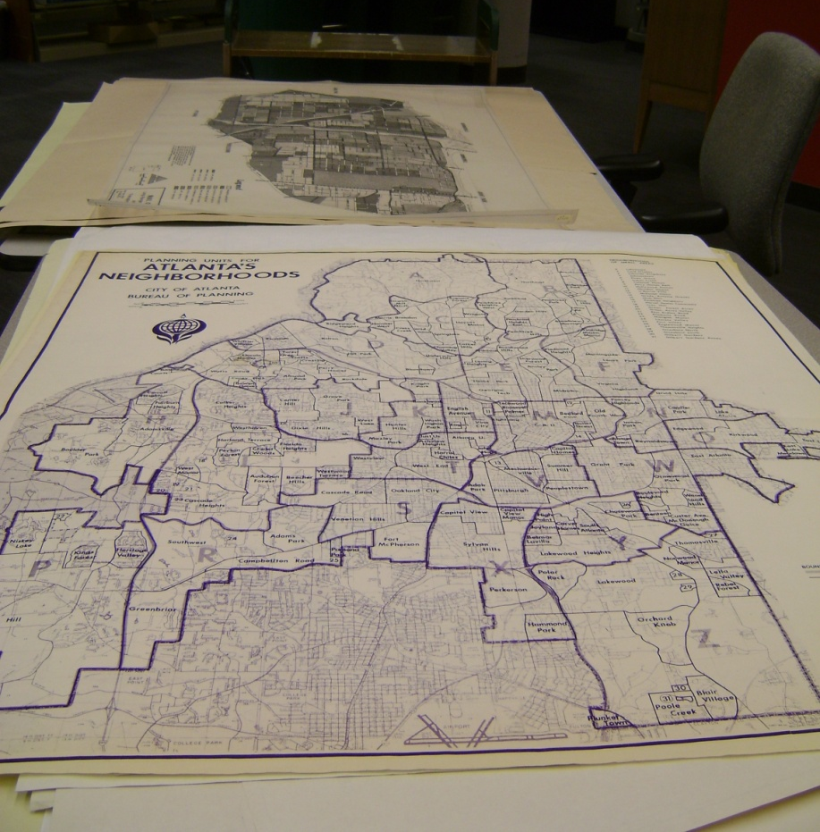
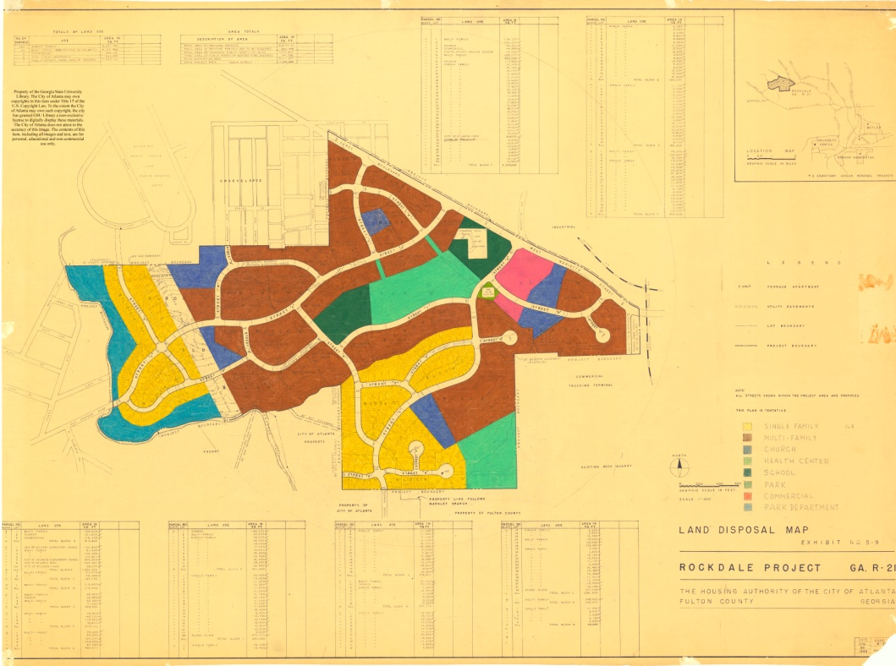
Maps in the Collection

Slide 4
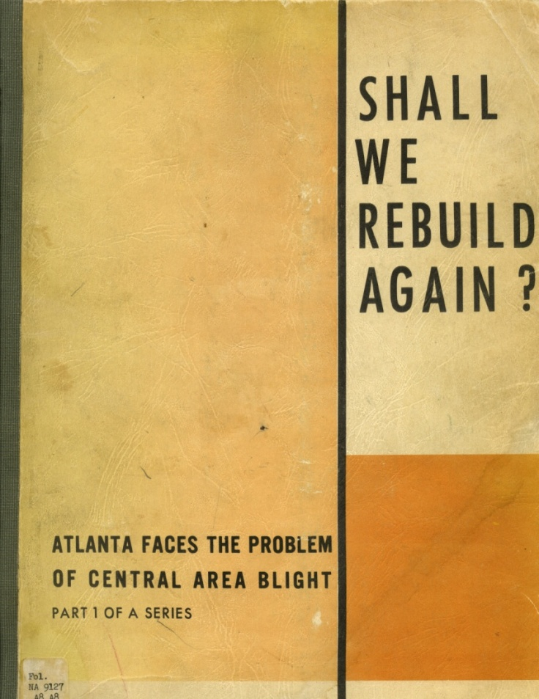
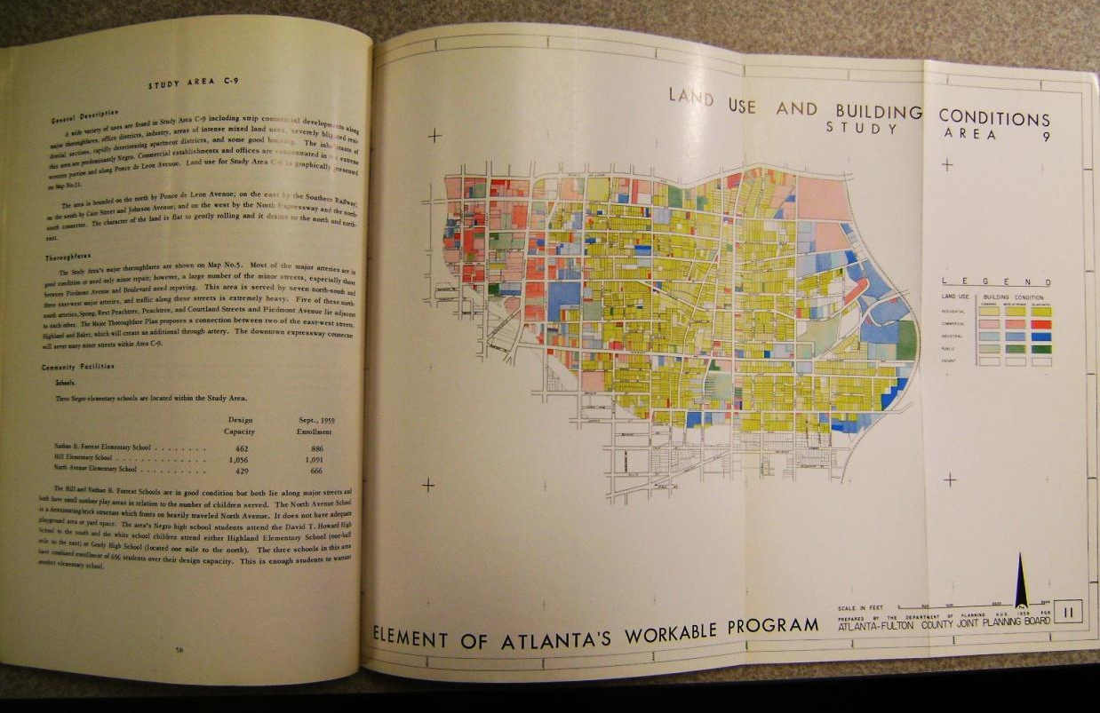
Publications and Documents in the Collection

Slide 5
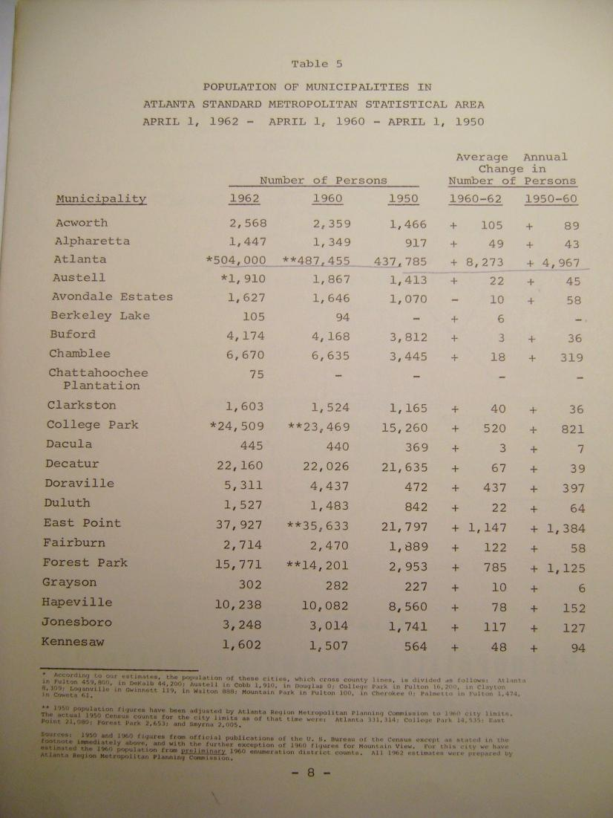
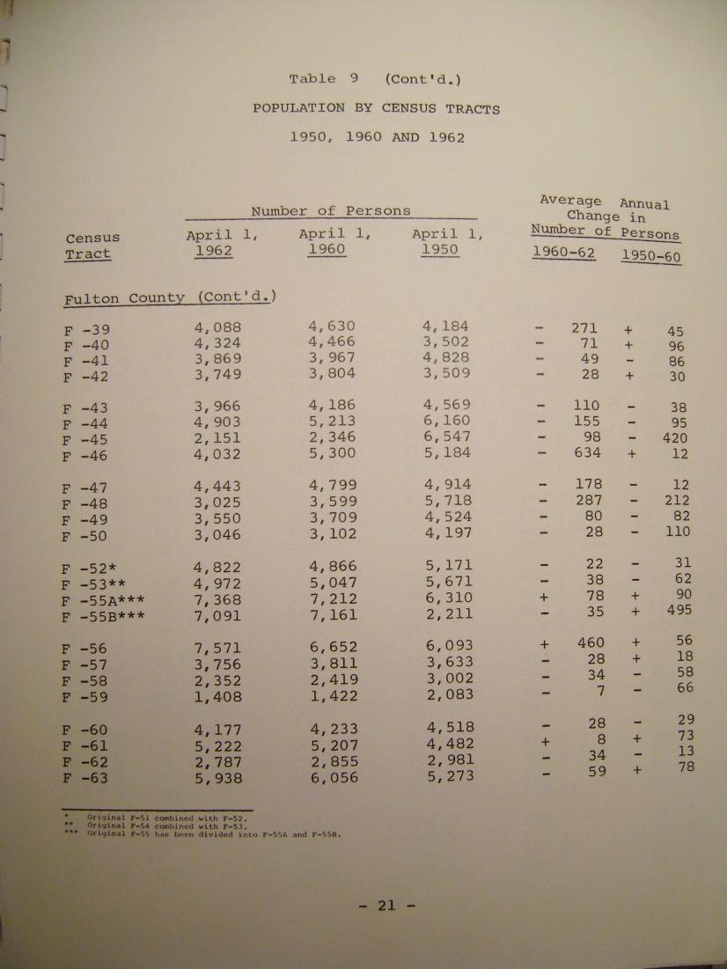
Publications and Documents in the Collection

Slide 6
Uniqueness and Richness of the Collection
Most of the maps are unique
Most of the maps were uncataloged and were hidden from the public
Contain detailed information from the regional to the local level
Contain social, demographic, built environment information

Slide 7
Multiple Ways to Engage with the Material
Users can:
  View each map online
  Download geotiffs
  Open each map in Google Earth as a super overlay
  Open each map in Google Maps

Slide 8
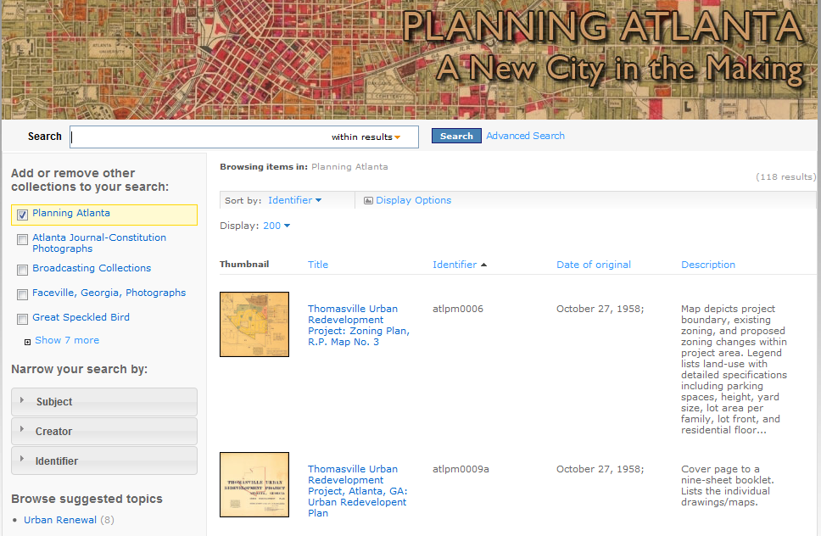

Slide 9
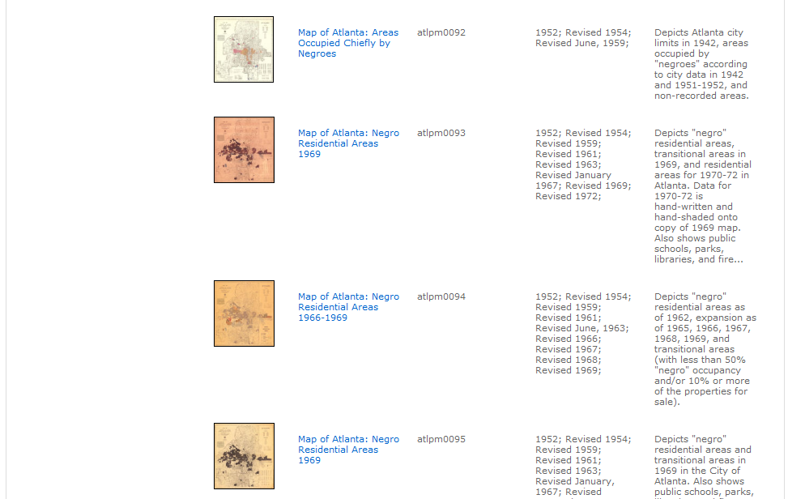

Slide 10
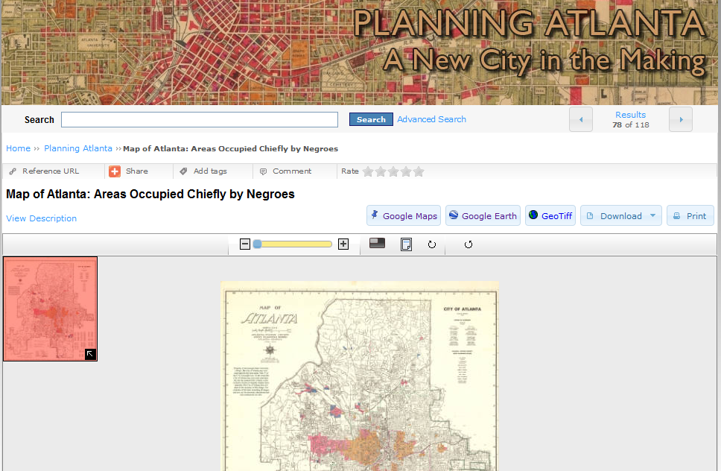

Slide 11
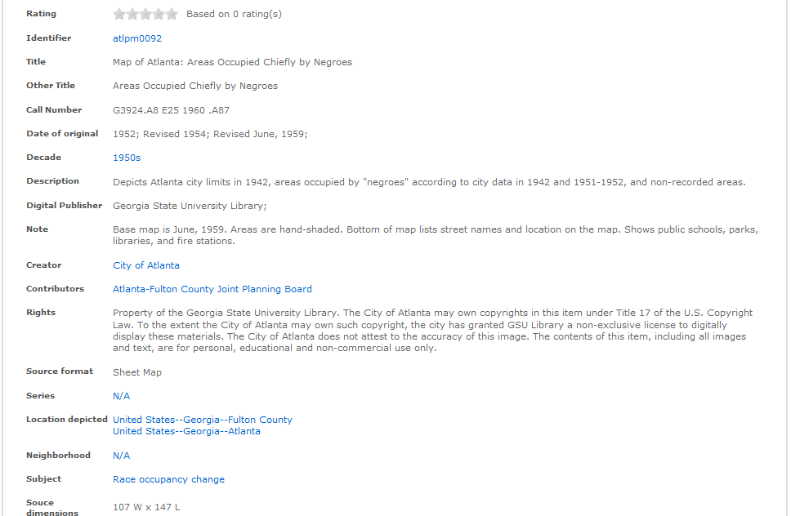

Slide 13
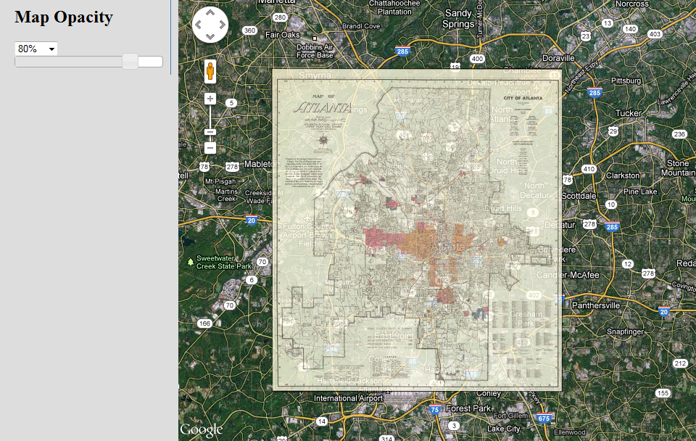

Slide 14
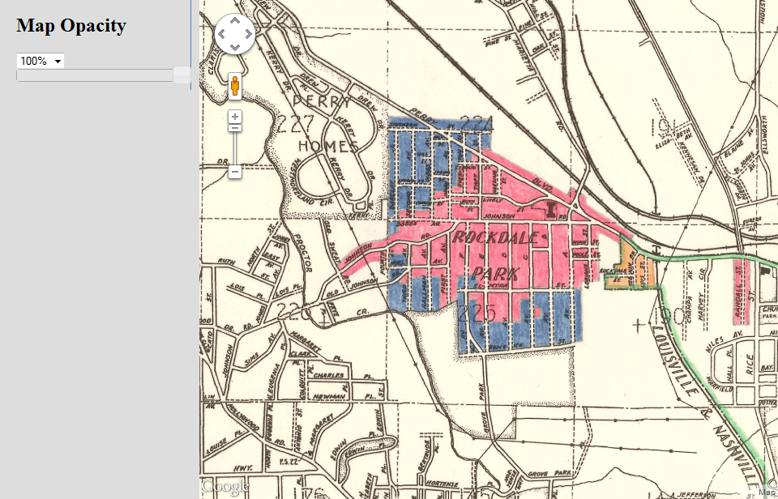

Slide 15
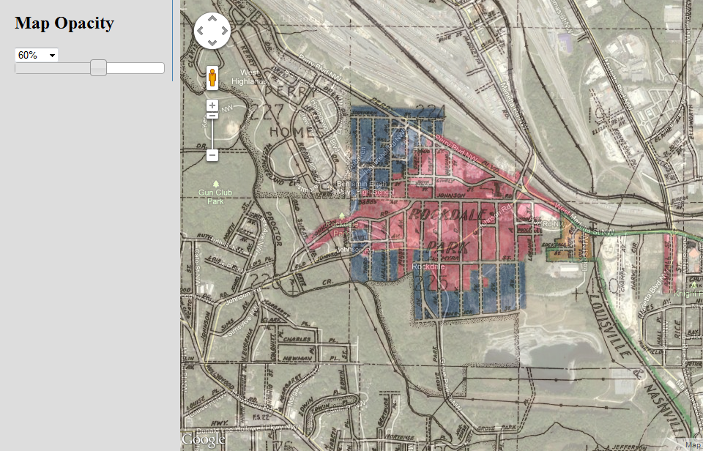

Slide 16
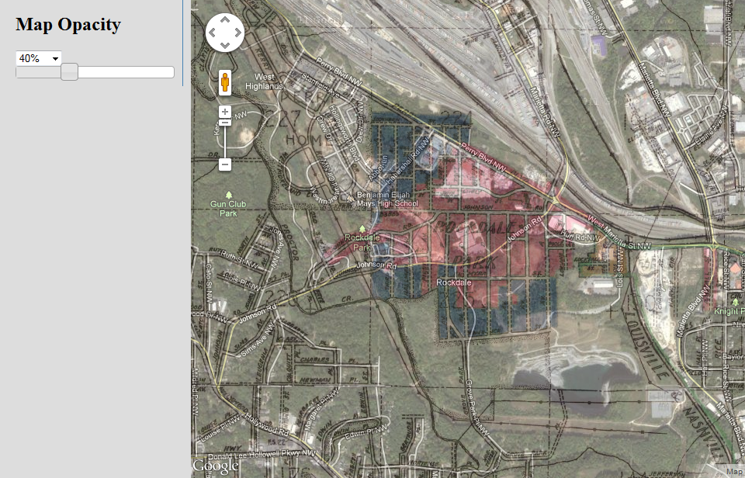

Slide 17
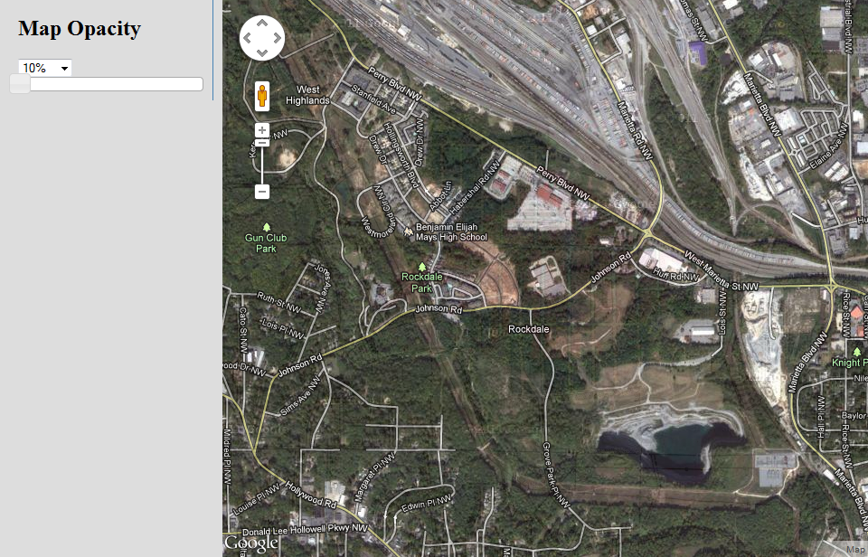

Slide 18
http://131.96.12.88/cdm/search/collection/MapsTest

Slide 19
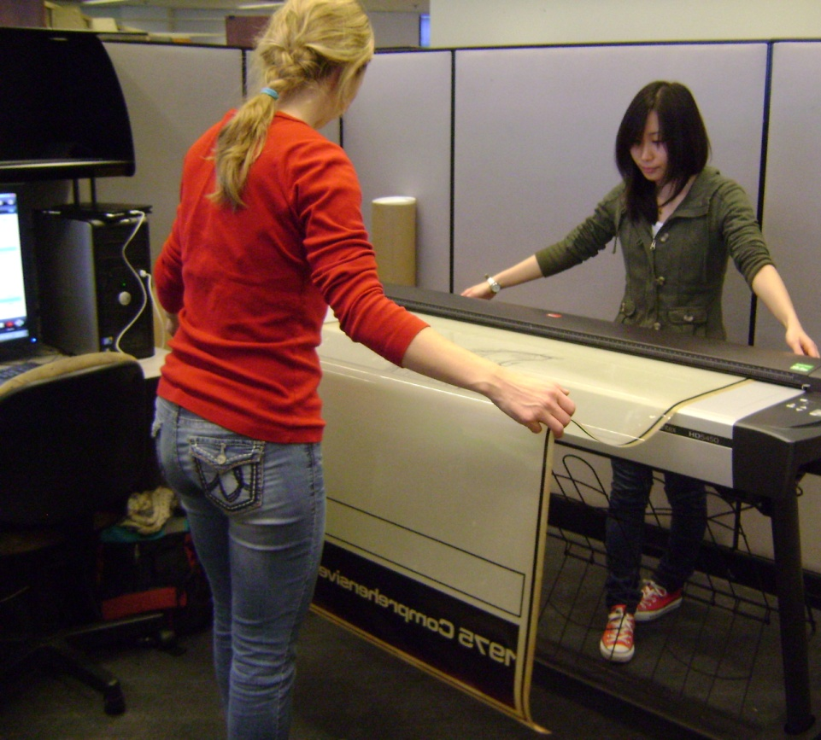
Project Personnel
1 GRA – creates metadata, scans maps, crops and watermarks the digital images, georeferences the maps and creates the Google Earth super overlays
3 undergraduate students – scan and georeference maps, create super overlays, add metadata to geotiffs
2 Digital Library Services librarians – upload content to our content management system, CONTENTdm
1 programmer – creates custom functions in CONTENTdm for the collection
1 map librarian – manages, plans and directs the project

